Slide 1



Programming With Data
CEIS110 Final Course Project
2024 May Session
Keith Warren
Dr. Tilghman

Slide 2


Introduction
The Volume of data is increasing at an exponential rate. This project leverages a cloud-based system to collect temperature and humidity data. Subsequently, the data is analyzed using programming and data analytics techniques.

Slide 3



Software Inventory
Software and tools used included – Python programming, Microsoft Excel and Replit software development platform

Slide 4
PLANNING & DESIGN
Following an inventory of the required software, a strategy was formulated for the temperature data project.
A flowchart was developed to outline the project design.
The planning and design phases are essential for grasping the development process.

Slide 5
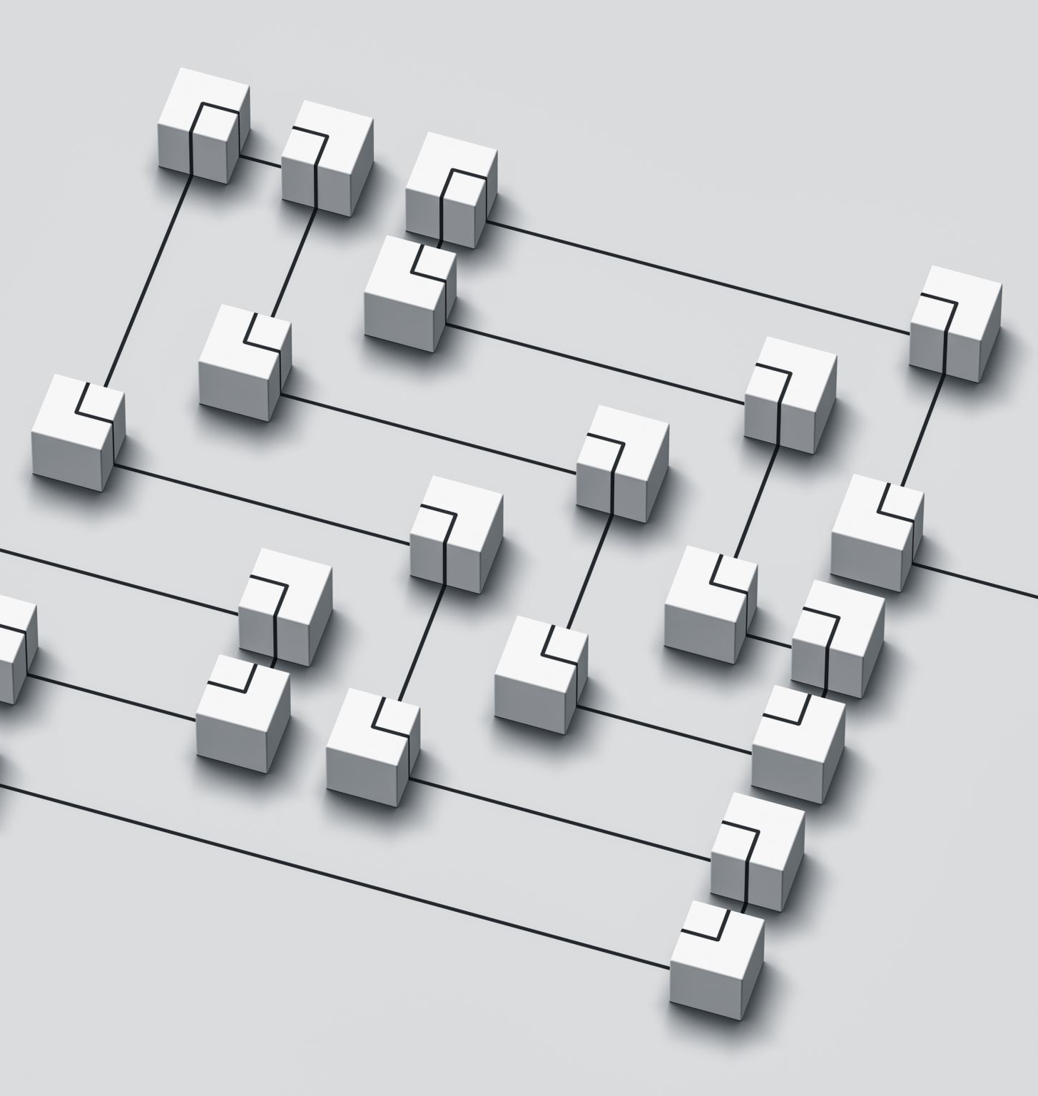
Flowcharts ?
Flowcharts visually represent processes or workflows. The flowchart created for this software development project showcases both the process and the final output.
Many companies use flowcharts for clear and straightforward communication.

Slide 6
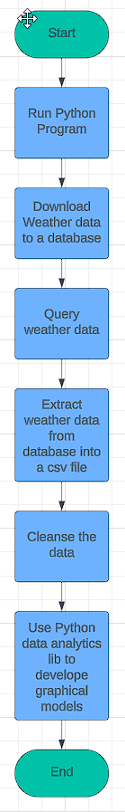
Flowcharts
Include the following processes:
Run a basic python program
Download weather data to a database
Query the weather data
Extract weather data from database into a comma separated file with python
Cleanse weather data
Use python data analytics modules to develop graphical models

Slide 7
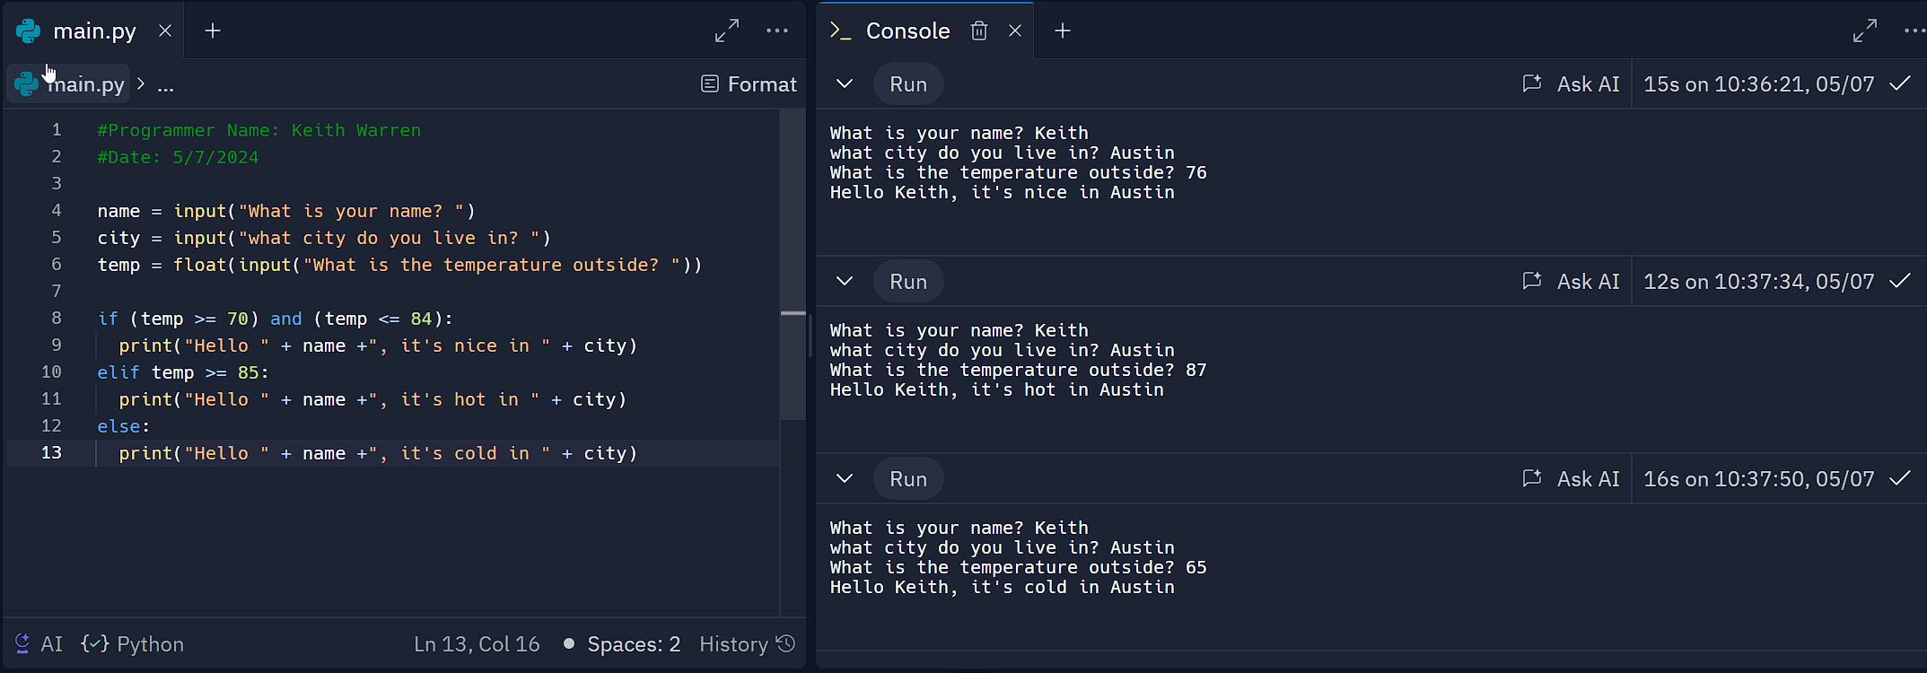
Intro to Python
Include the following processes:
Python is a popular programming language used for game programming, data analytics and web development.
This program illustrates a selection control structure in python

Slide 8
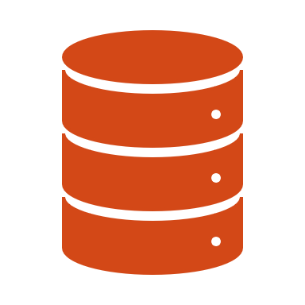
Collecting Temperature & Humidity data
Following the planning and design phase, I developed code to download a set of weather observations for Georgetown, Texas. This data was then stored in a local database table for later analysis.

Slide 9
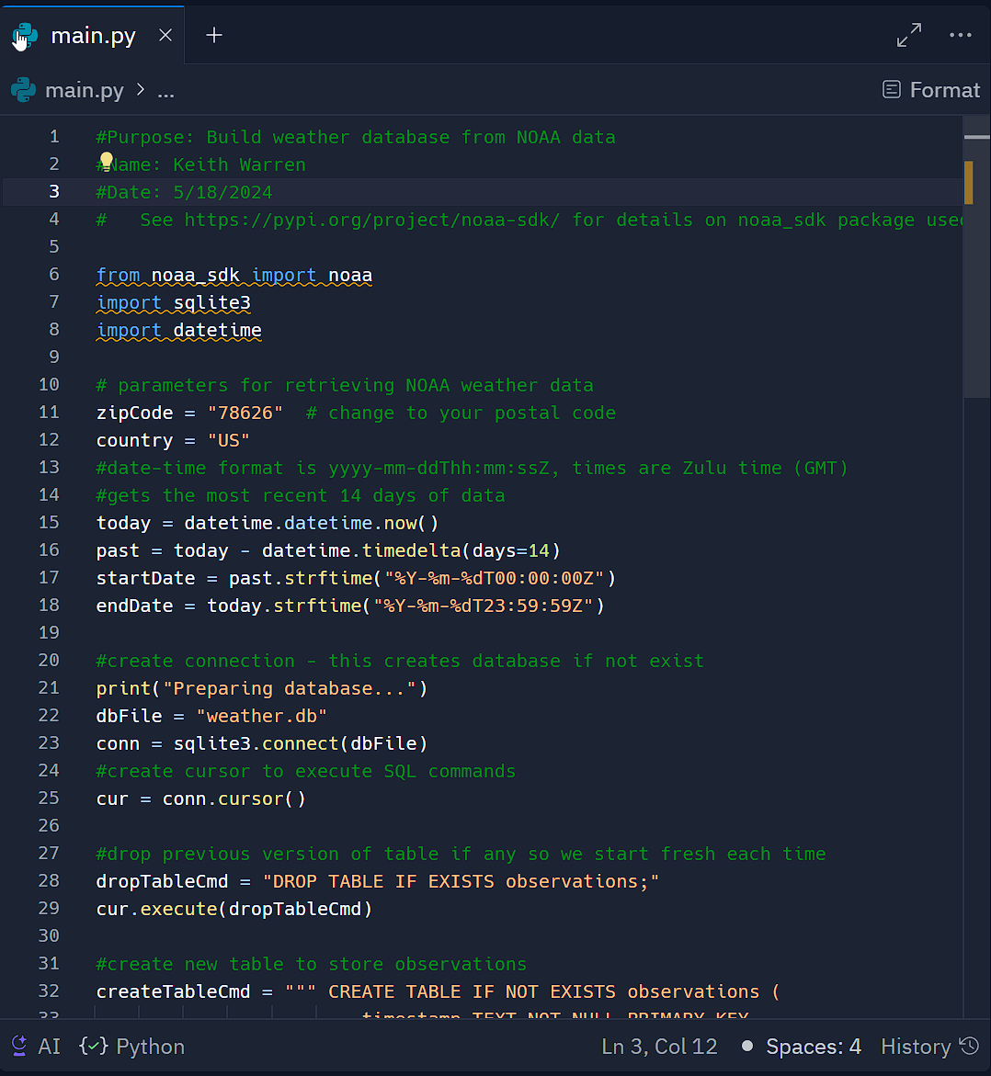
BuildWeatherDb.py Code (screenshot)
Screenshot of code in Replit:
The code creates a table named 'Observations' with the fields: 'timestamp', 'windspeed', 'temperature', 'relativeHumidity', 'windDirection', 'barometricPressure', 'visibility', and 'textDescription’.
The database will be named 'weather.db' and stored in the same directory as the Python code.

Slide 10
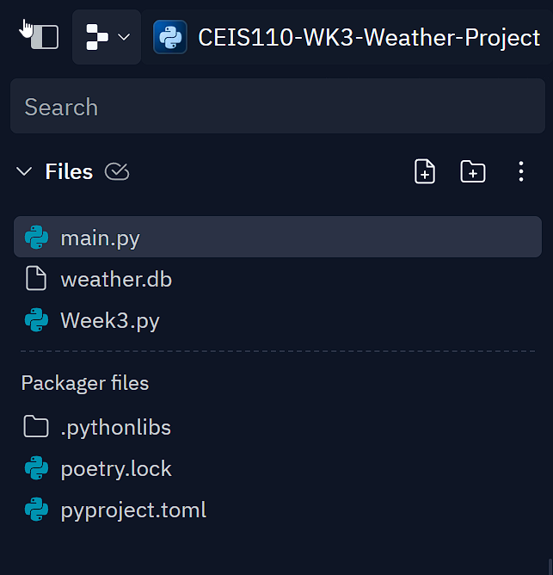
WeatherDb.py file (screenshot)
Screenshot of file in Replit:
The database named 'weather.db’ which is stored in the same directory as the Python code.

Slide 11
Querying the Database
Structure Query Language (SQL) is a programming language designed for managing and interacting with relational databases.
SQL was utilized to query the database and display the results.

Slide 12
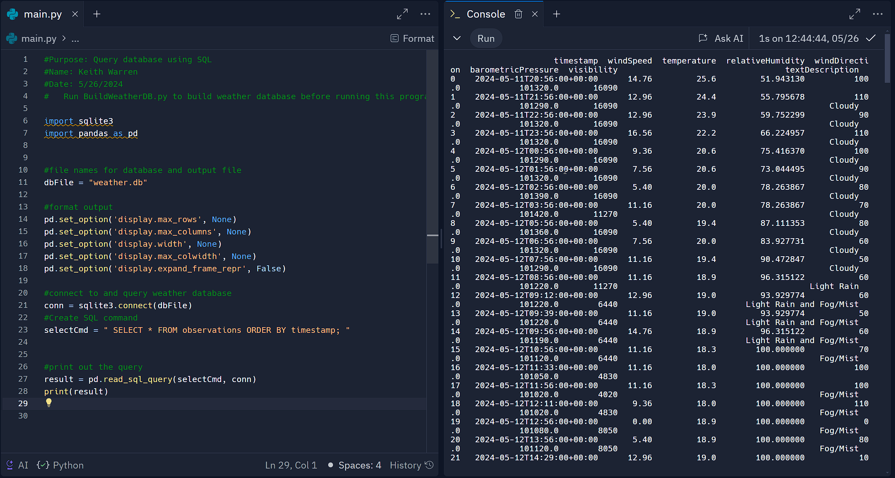
Query to Retrieve all Columns & All Rows (screenshot)
To retrieve all columns and rows, the SQL command ‘SELECT * FROM observations’ was executed, fetching all rows and columns from the observations table.

Slide 13
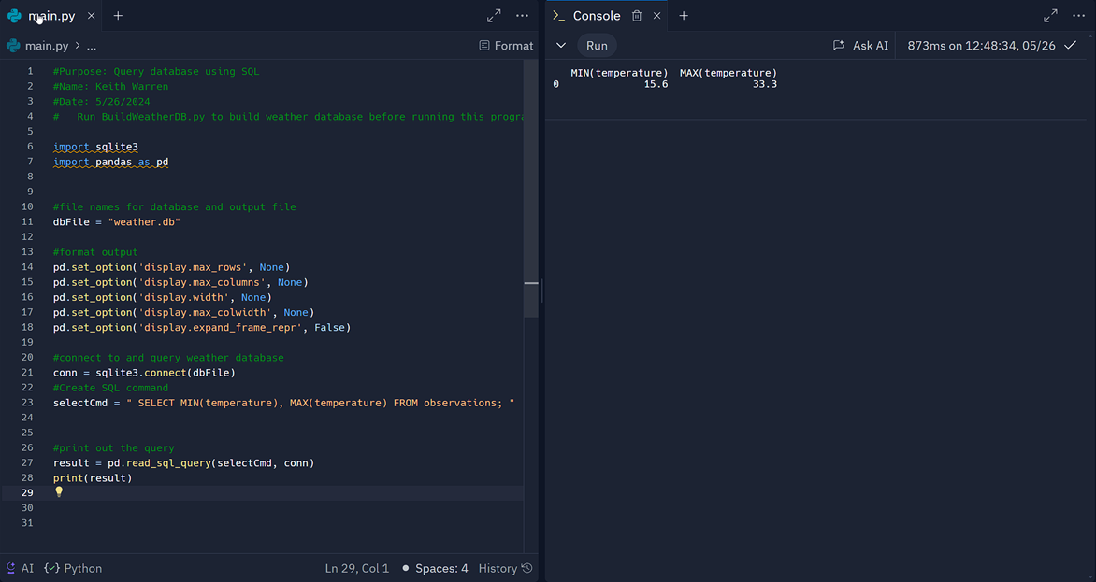
Query to Retrieve Lowest & Highest Temperatures (screenshot)
The minimum and maximum temperatures were obtained, and they are recorded in Celsius.

Slide 14
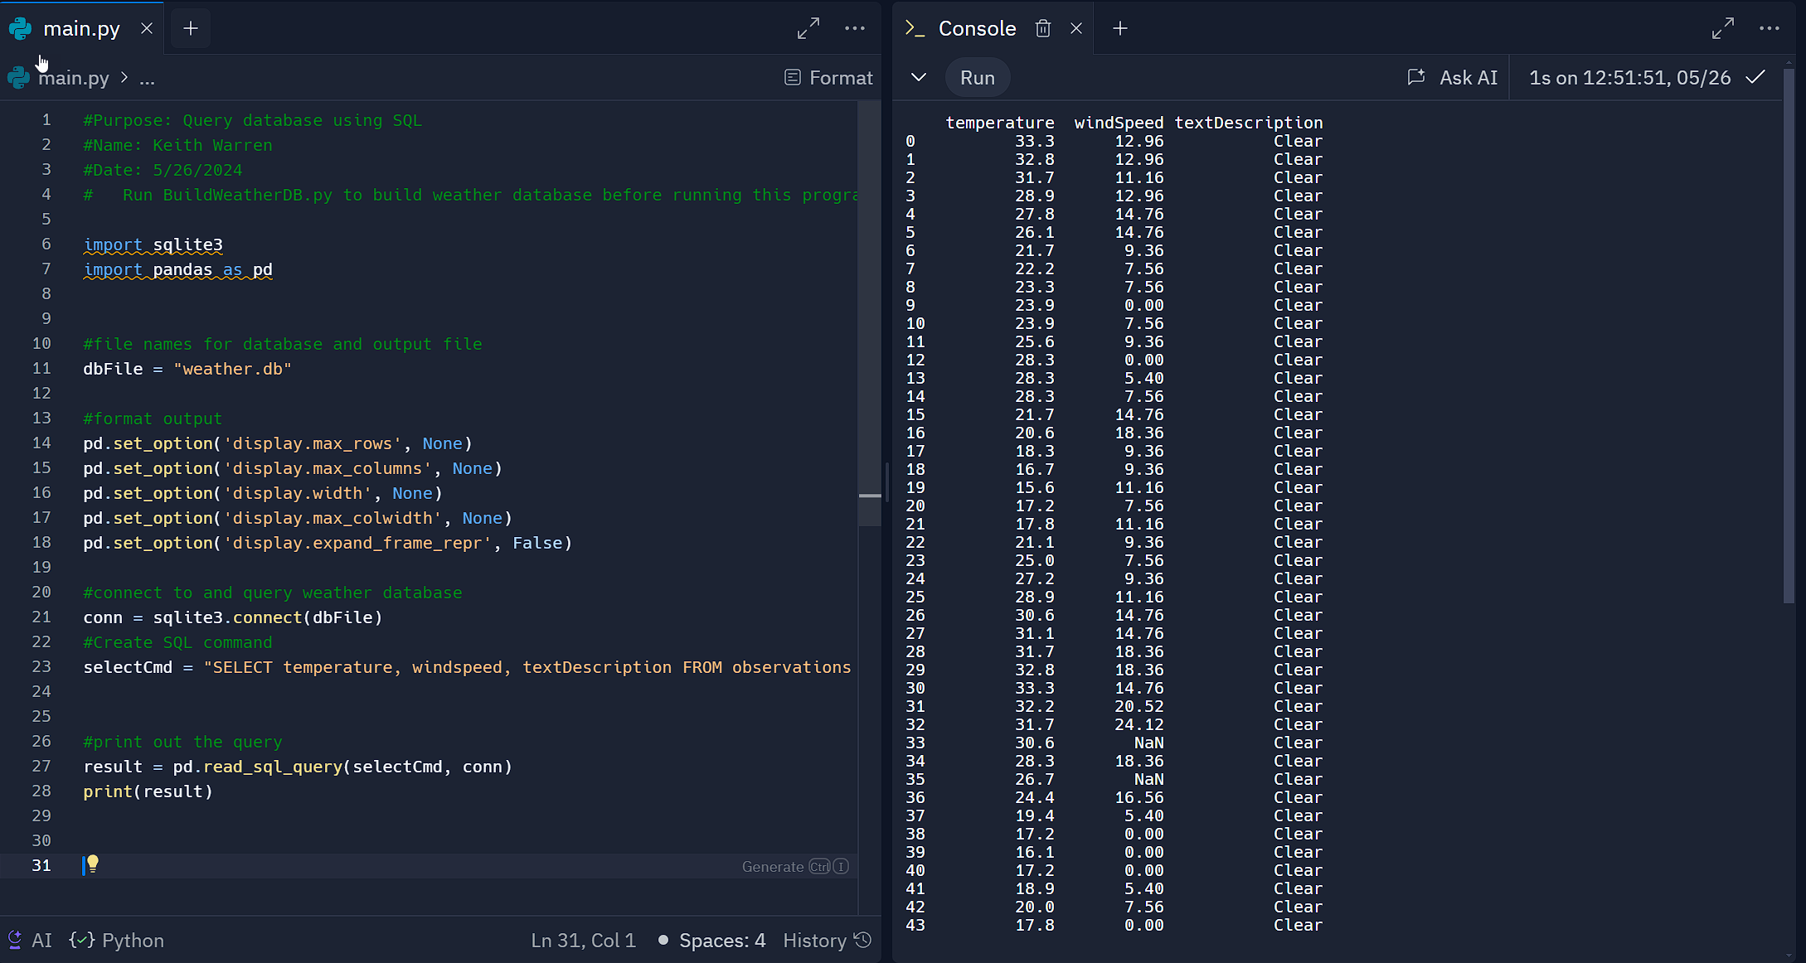
Query to Retrieve Clear Days (screenshot)
A new query was conducted to obtain the ‘temperature’, ‘windspeed’, and ‘textDescription’ for clear weather conditions.

Slide 15

Data Cleansing
Data output from machines often contains errors and extraneous information. During data cleansing, programs can automatically format it for compatibility with other systems.
A Python program processes the data output by another Python program and saves it in a CSV file, making it accessible in Excel.
It's common for datasets to require cleaning to remove spurious or missing values. Ensuring the data is complete, valid, and standardized is crucial.

Slide 16
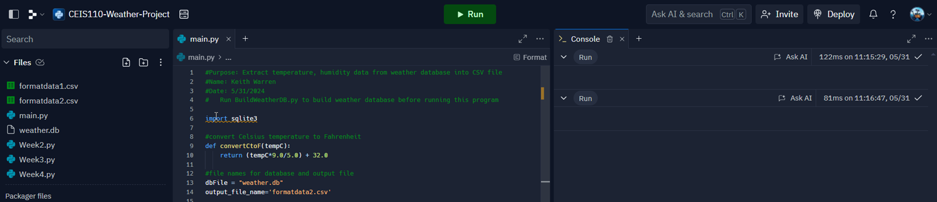
Extracting Temperature & Humidity using Python
The weather.db database could have null or missing values. This code fetches the temperature and humidity values exclusively, and saves them in a CSV file, with two files being generated (formatdata.csv and formatdata2.csv), each containing half of the rows.
Any missing or invalid values are omitted from the file.

Slide 17
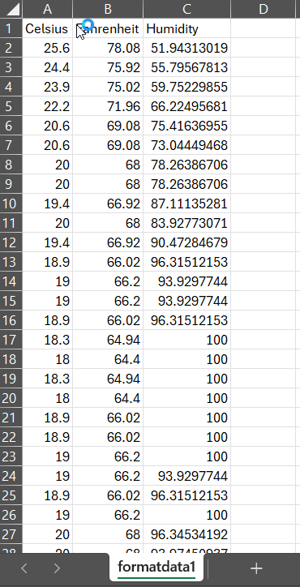
Data Formatted in Excel Spreadsheet
The python program created a formatdata.csv file
The file contains 3 columns: Celsius, Fahrenheit, and Humidity.
Statistics can be performed on this Excel spreadsheet.

Slide 18
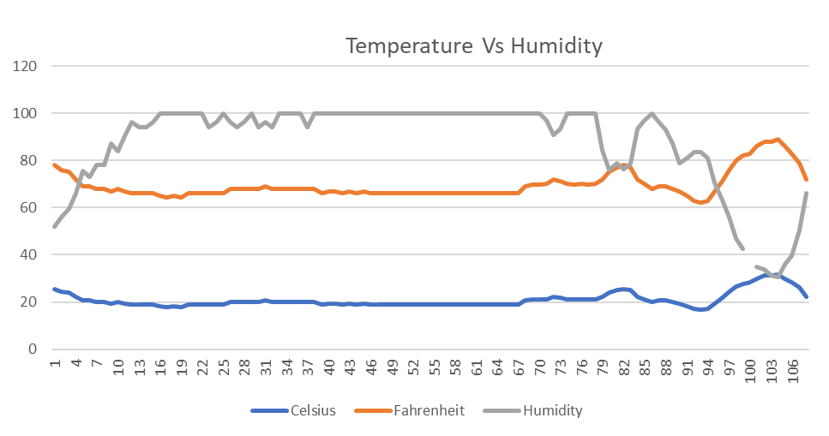
Data Visualization
An Excel line chart was created to display the Temperature and Humidity data for period 1.

Slide 19

Data Analytics
Python data analytics modules allows users to develop charts and graphs depicting data.
Data sets can be manipulated and saved into tabular format.
The python data analytics modules are available as part of Anaconda.
Several plots were generated looking at humidity and temperature.
Finally, a prediction was made about the data.

Slide 20
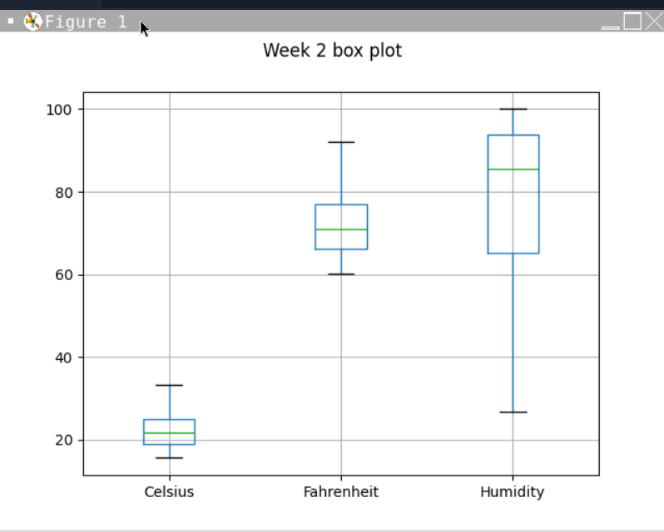
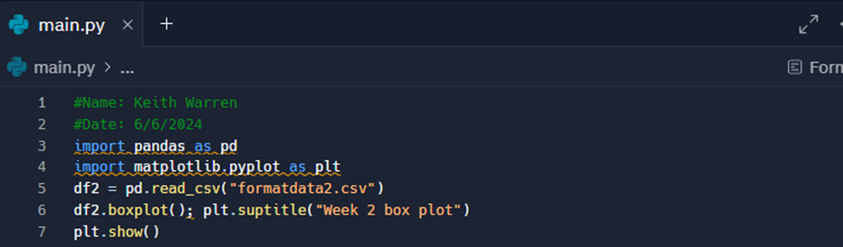
Box Plot

Slide 21
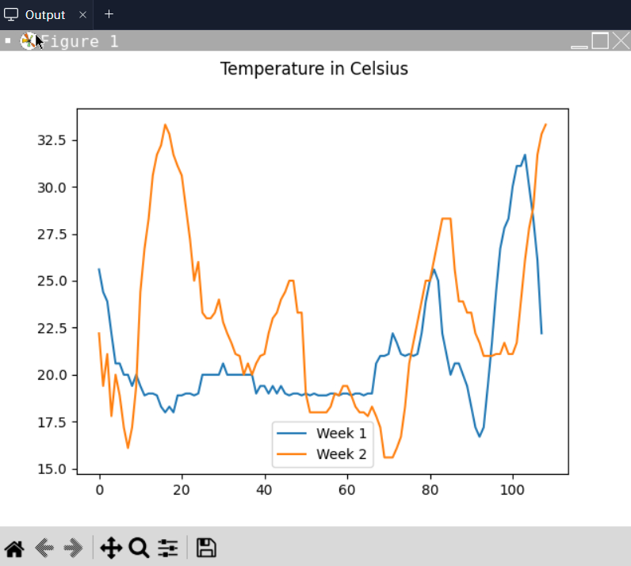
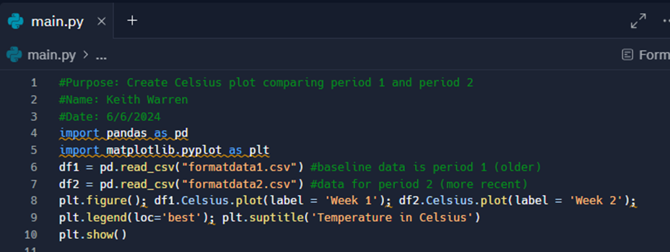
Line Plot

Slide 22
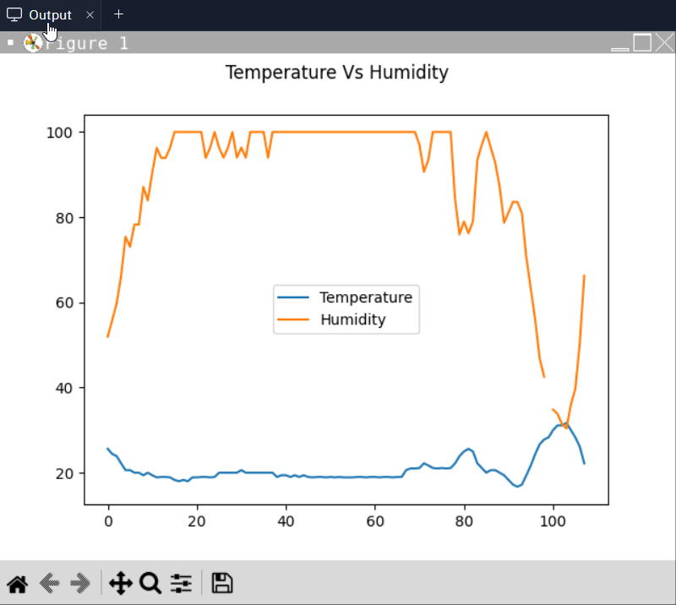
Analysis
Is there a relationship between temperature and humidity?
Answer supported by Chart: There is very little change between temperature and humidity. Like the help video, there is a little inverse relationship in my data.

Slide 23

Prediction
Based on my analysis of the data, I predict that both the temperature and humidity will rise over the next coming hours through the next few days.

Slide 24
Challenges
Using Replit was straight-forward and easy as it automatically installed any libraries I need when I ran my code.
Moving my code to VSCode, I had to learn how to install the needed libraries to get my code to work again.
Misspelled words. Remember to check spelling. Start in VSCode next time.

Slide 25

Career Skills
Based on the cloud-based system created to collect temperature and humidity data project during this course, here are some of the skills and competencies I developed to help advance my career.
Skills Developed:
Analytical Skills: The ability to analyze data.
Basic Programming with Python: Being able to read, write and edit Python code.
Problem Solving: Being able to identify problems and develop efficient solutions.
Communication: The ability to create flowcharts and depict the plan of the project.
Adaptability: Willingness to learn and adapt to new technologies and methodologies.

Slide 26

Conclusion
In summary, this course delved into the core concepts of data programming demonstrating how to utilize data sourced from a cloud service for data analytics tasks.
Creating this project offered a practical hands-on learning experience to apply the courses teachings.
Thank you!

