Slide 1
CEIS114 Course Project Traffic Controller
2024 July Session
Keith Warren
Prof. Kavianpour

Slide 2
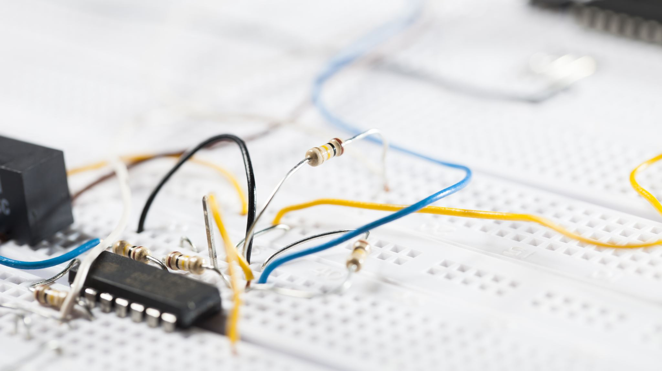
Introduction
Project Overview:
Building and programming of two-way traffic light controller with a pedestrian crossing and emergency signal that can be controlled securely and remotely via a web browser or mobile application.
Objectives:
Design and simulate circuits using Wokwi.
Build and program the hardware components for real-world testing.
Implement basic and advanced features to monitor and control traffic lights securely.

Slide 3
CEIS114 Module 2
Project Plan for IoT Traffic Controller

Slide 4
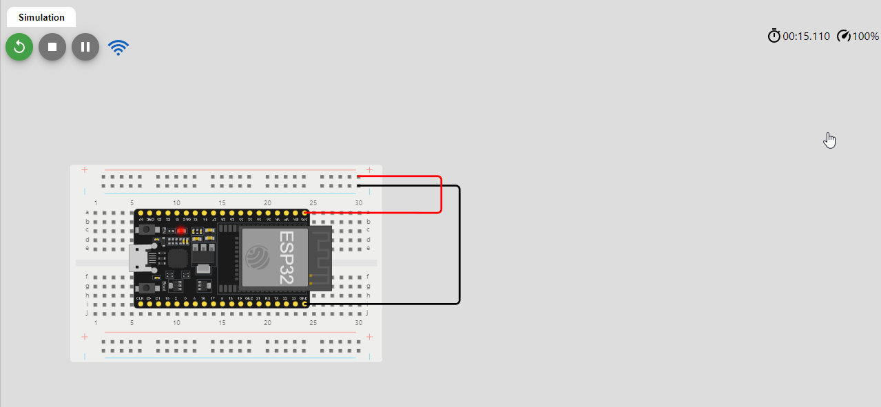
Circuit (screenshot)

Slide 5
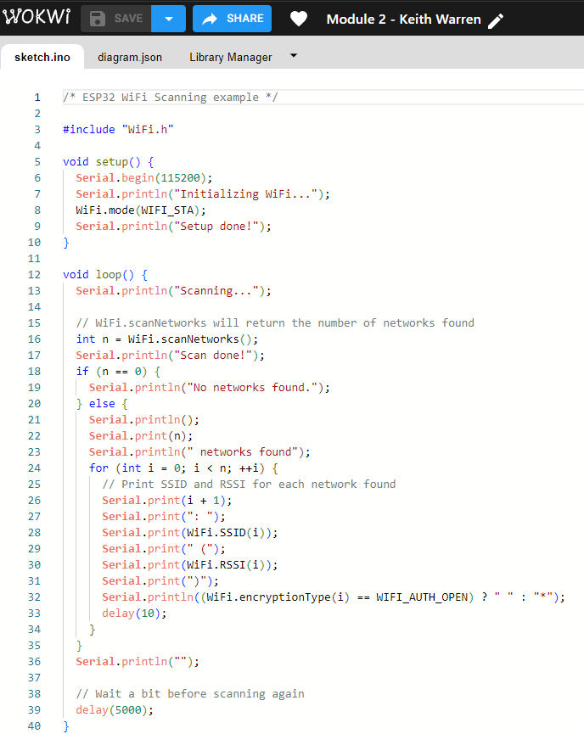
Code (screenshot)

Slide 6
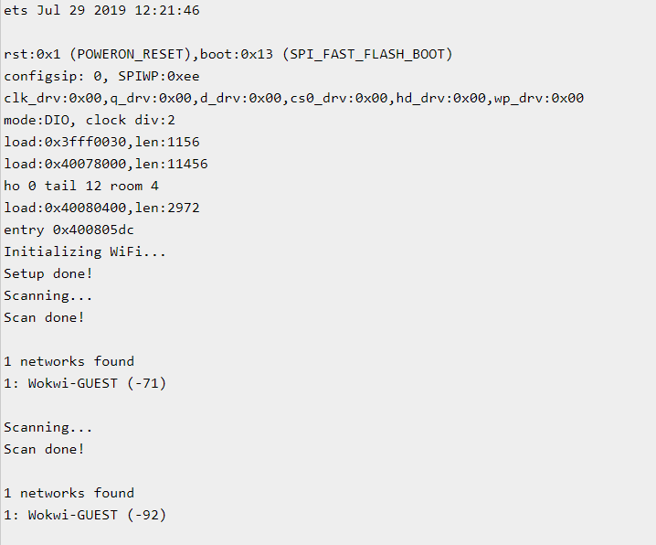
ESP32 WiFi Scan (serial Monitor Output)

Slide 7
CEIS114 Module 3
Creating the Traffic Controller

Slide 8
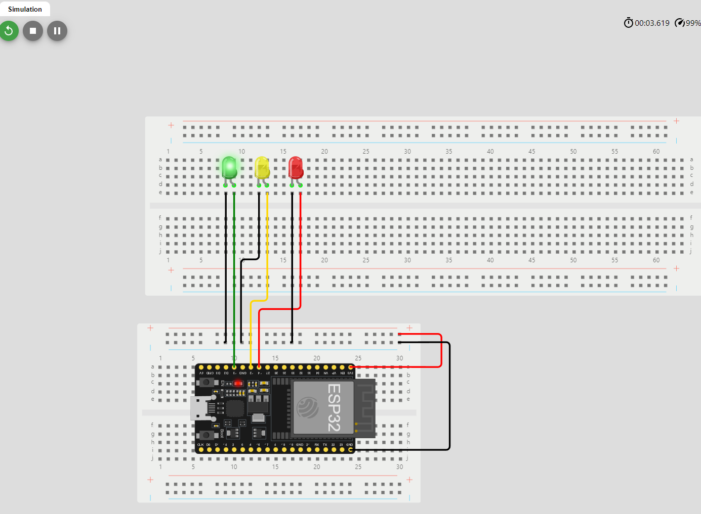
Circuit with working LEDs (picture)

Slide 9
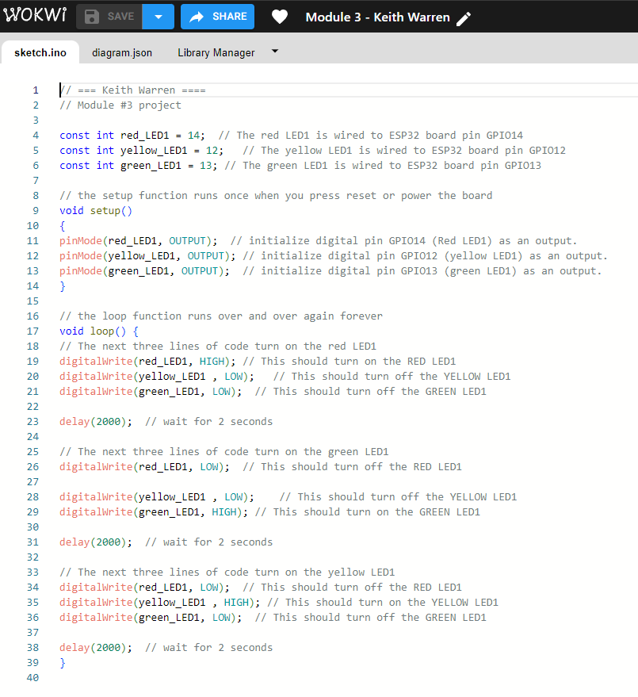
Code (screenshot)

Slide 10
CEIS114 Module 4
Creating Multiple Traffic Lights

Slide 11
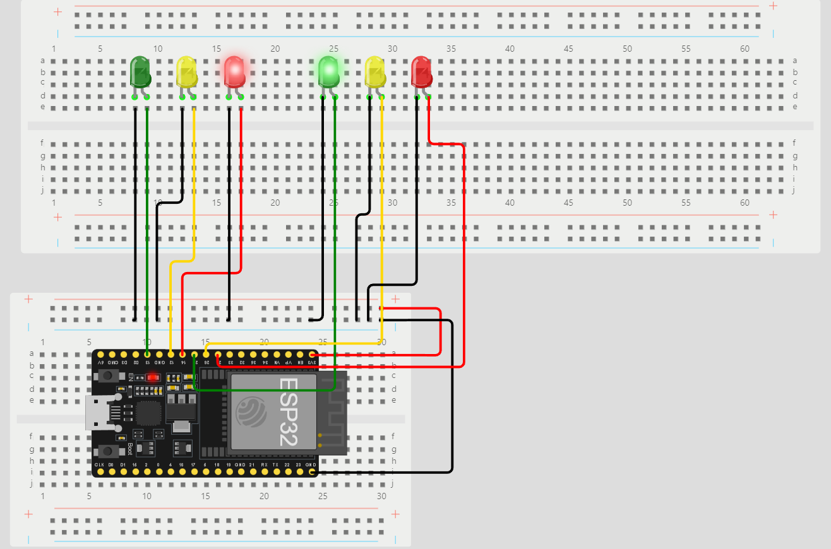
Circuit with Multi LEDs (picture)

Slide 12
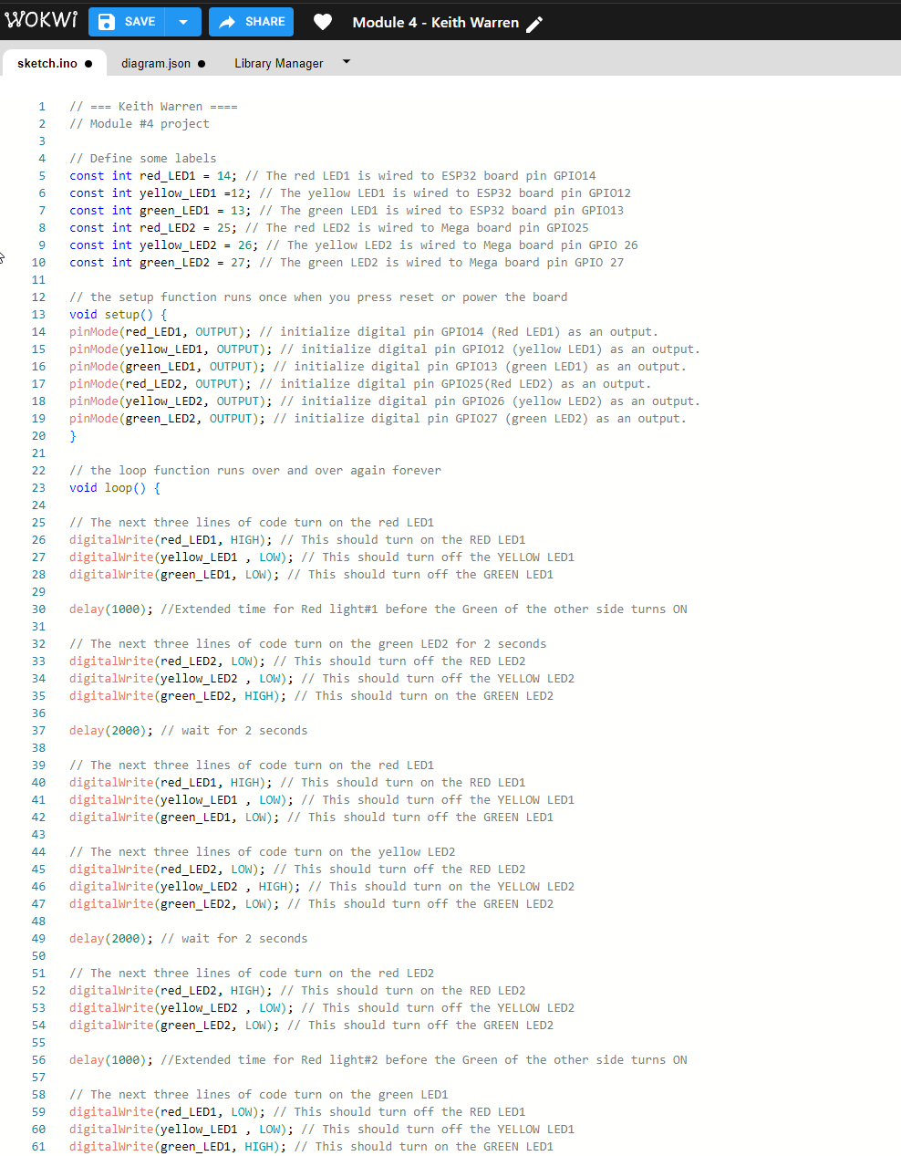
Code (screenshot)

Slide 13
CEIS114 Module 5
Mulitple Traffic Lights with Cross Walk

Slide 14
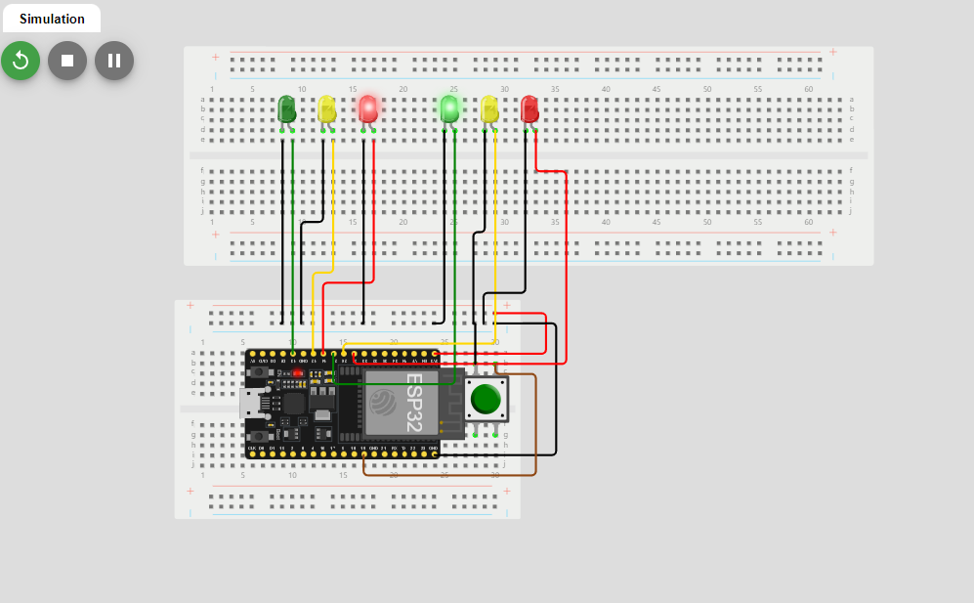
Circuit with working LEDs (picture)

Slide 15
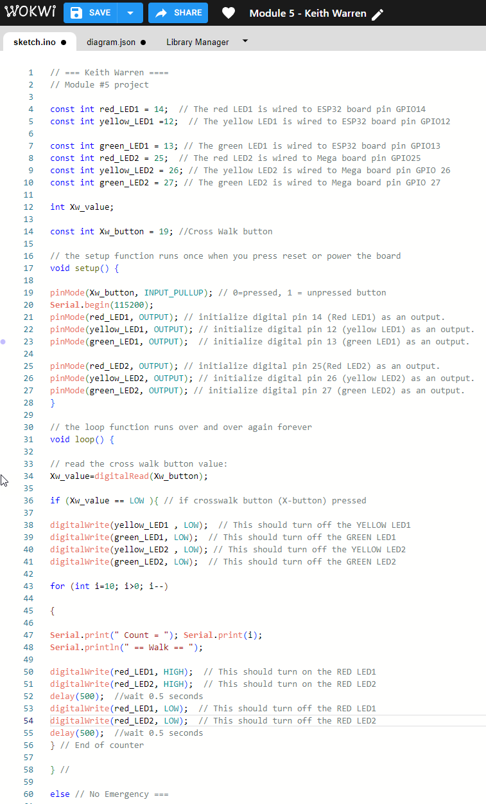
Code (screenshot)

Slide 16
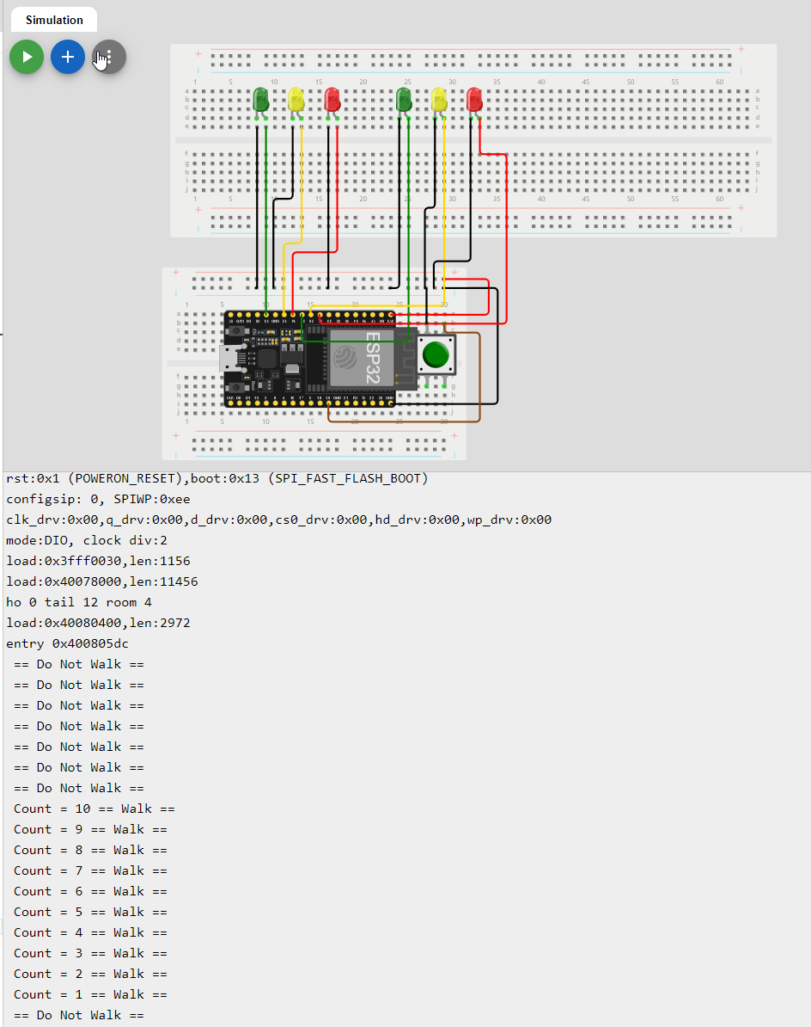
Cross Walk Serial Monitor Output (Screenshot)

Slide 17
CEIS114 Module 6
Multiple Traffic Lights with Cross Walk, Buzzer and LCD Display

Slide 18
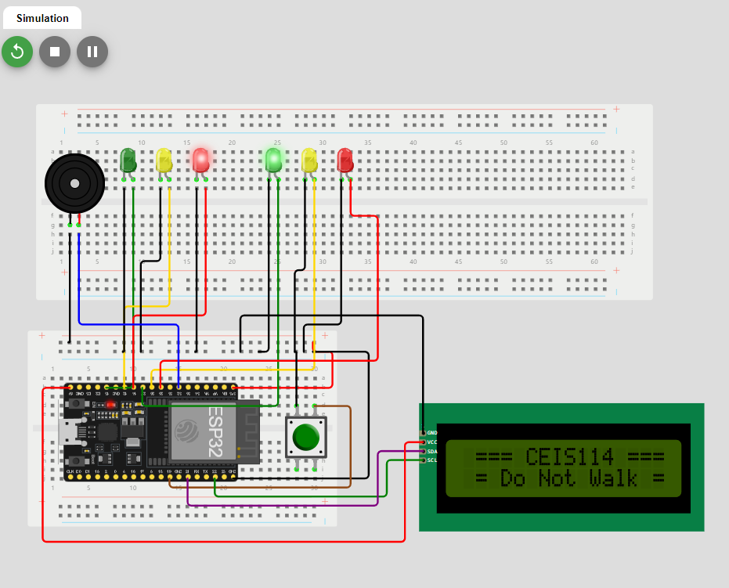
Circuit with Working LEDS and LCD Display (picture)

Slide 19
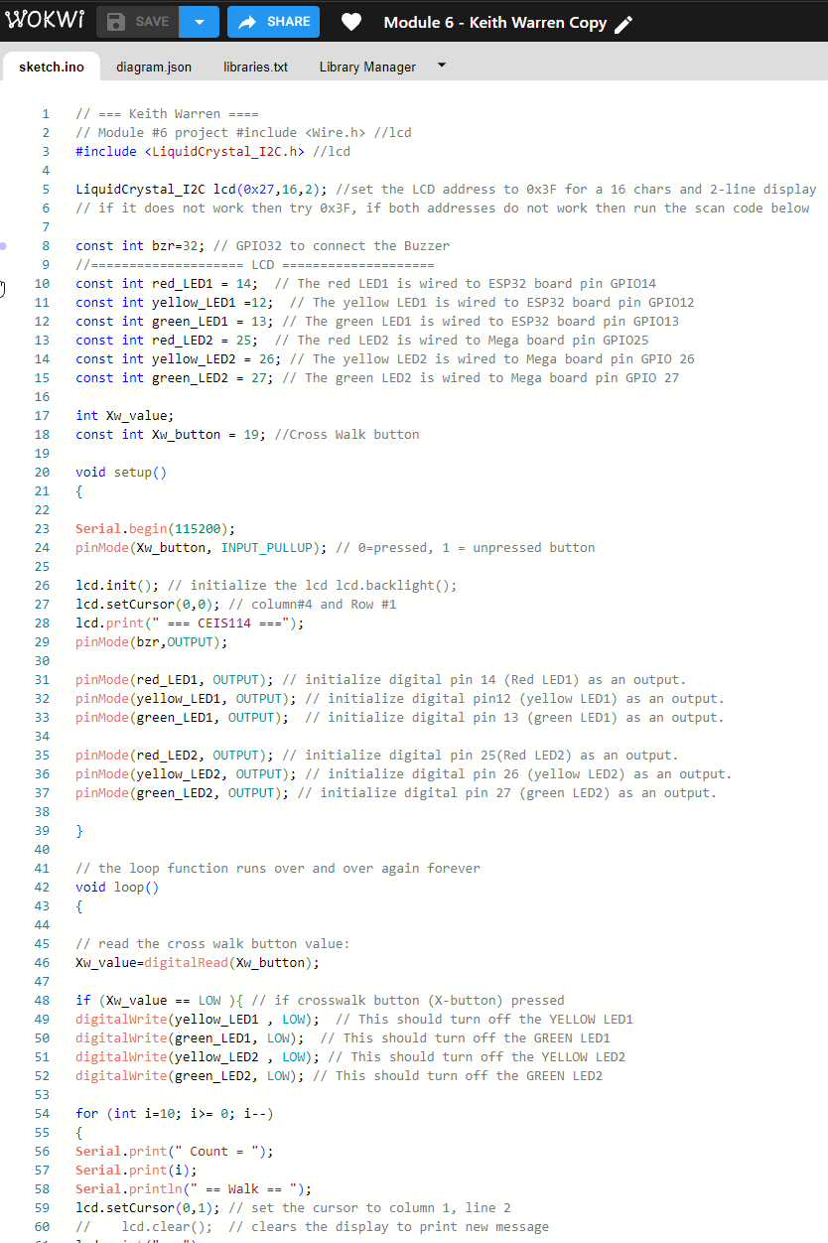
Code (screenshot)

Slide 20
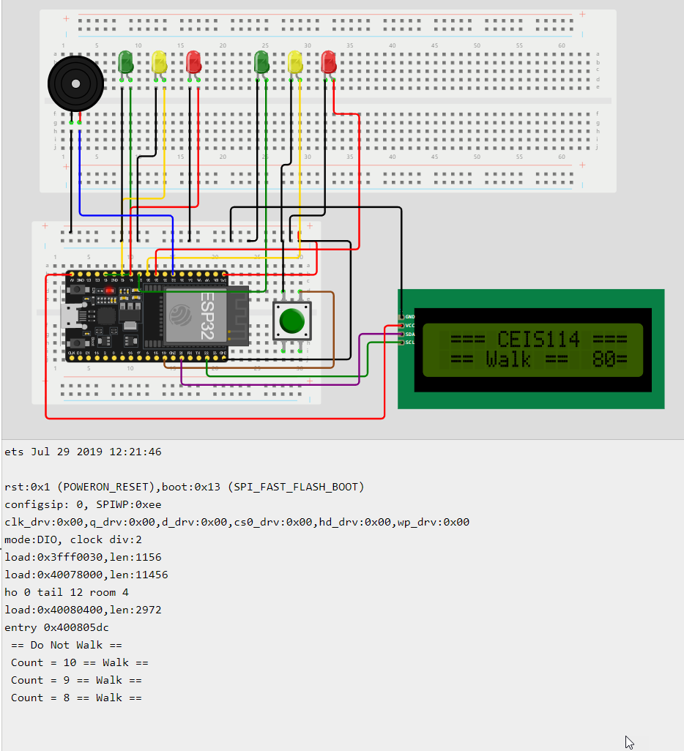
Cross Walk Serial Monitor Output (Screenshot)

Slide 21
CEIS114 Module 7
Multiple Traffic Lights with Cross Walk, Buzzer, LCD Display and Remote Emergency Control

Slide 22
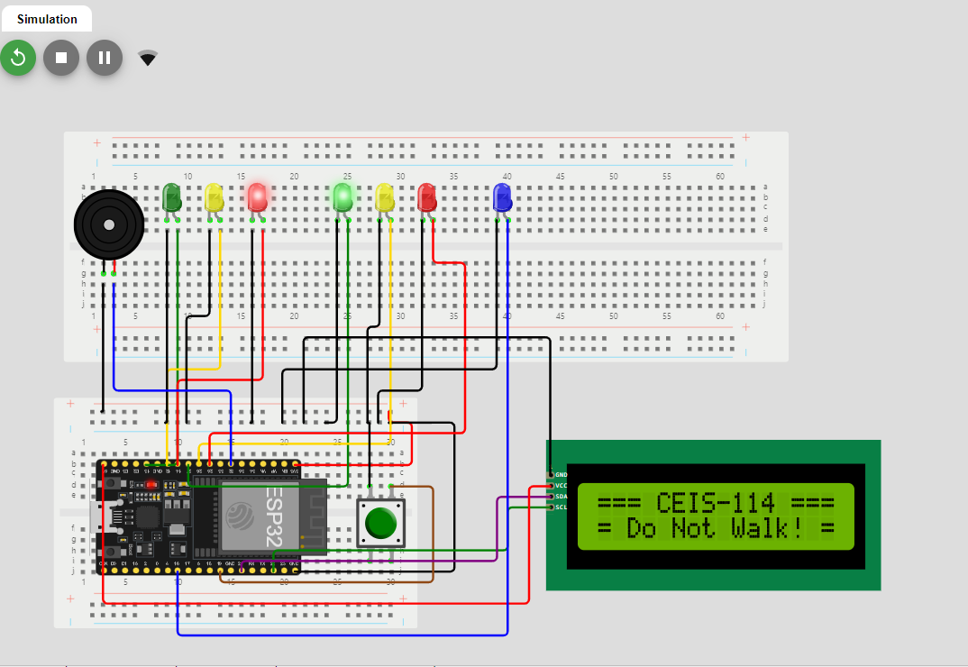
Circuit with Working LEDS and LCD Display (picture)

Slide 23
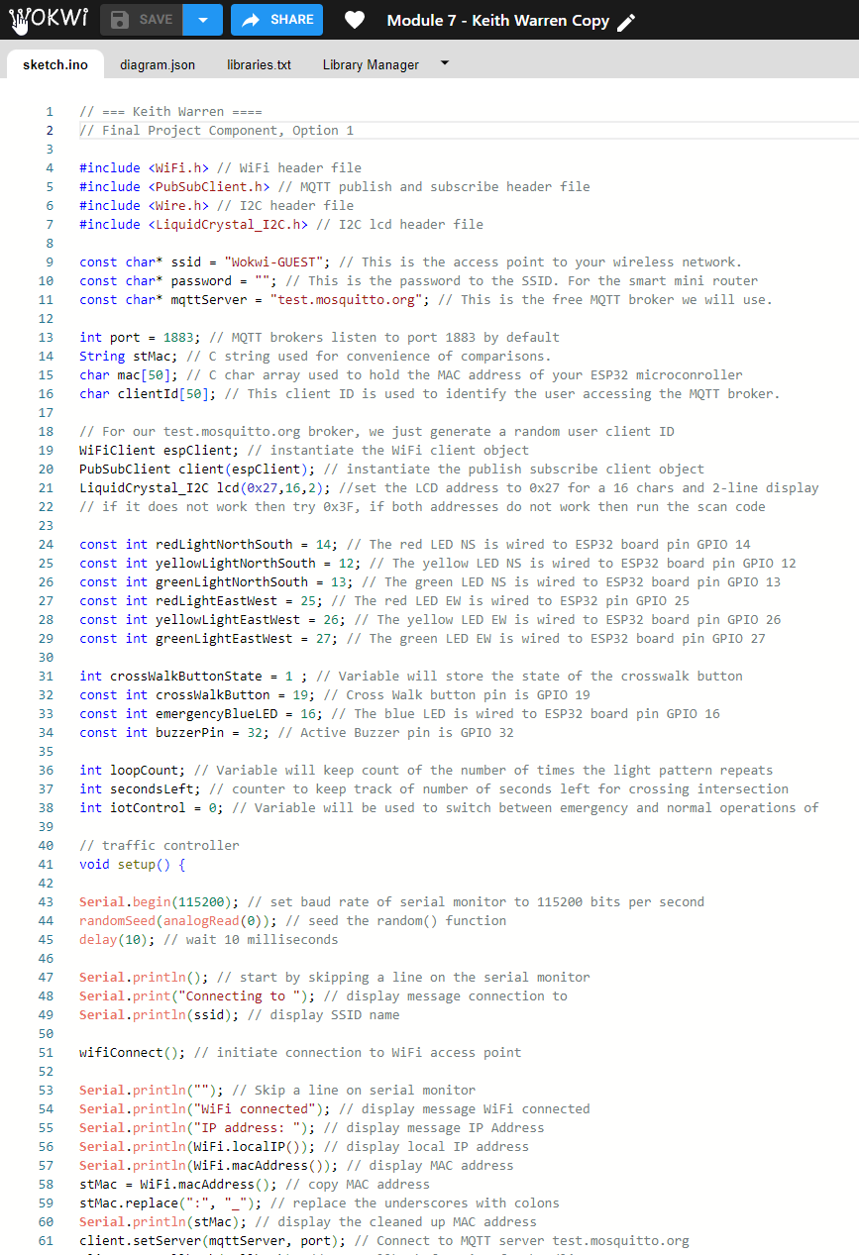
Code (screenshot)

Slide 24
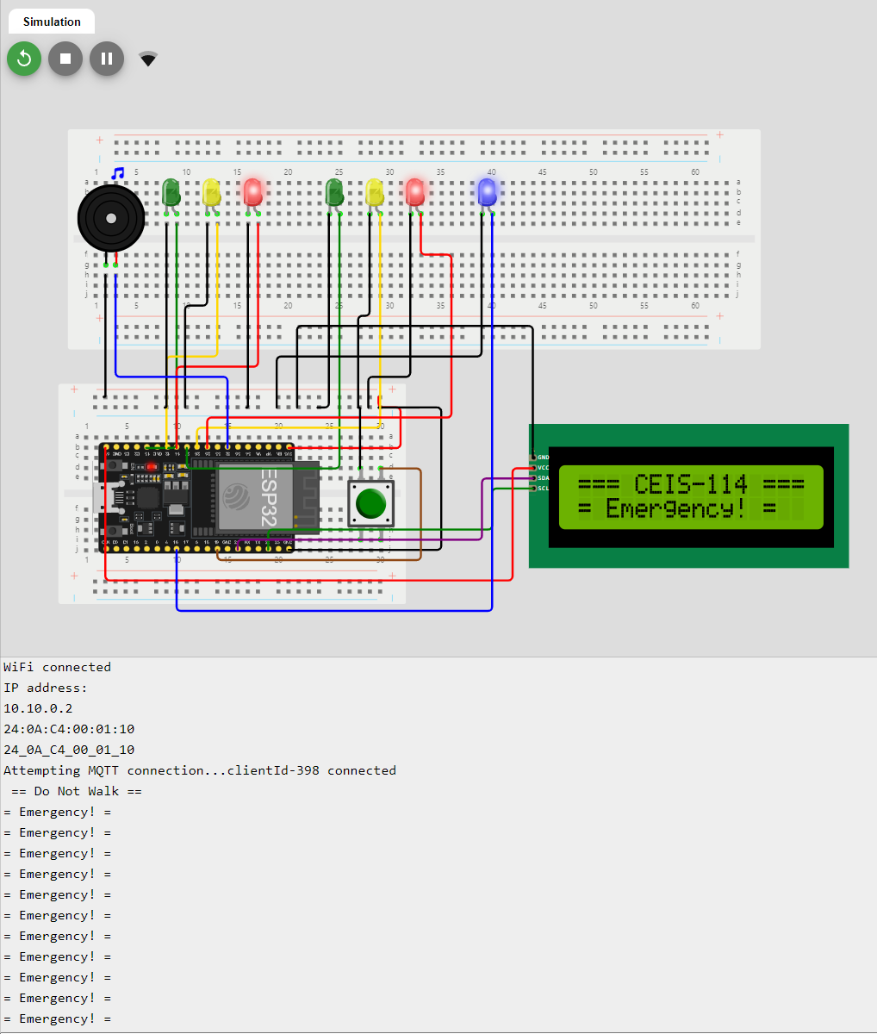
Cross Walk Serial Monitor Output showing emergency control active (Screenshot)

Slide 25
Challenges/Lessons Learned
Manipulating two breadboards for ESP32
Determining correct placement for ESP32, button, LEDs, buzzer, and LCD display
Setting up correct libraries (LiquidCrystal I2C, PubSubClient, WiFi)
Connecting IoT MQTT Panel with WiFi

Slide 26
Career Skills
Understanding of the IoT
Hardware/Device Knowledge
Networking/Connectivity Ability
Coding/Programming
Operating System Fundamentals
Automation
Security Awareness

Slide 27
Conclusion
In conclusion, this course led to the successful development of a fully functional multi-traffic light system with integrated crosswalk and emergency control, accessible through a mobile application/web browser prototype. This system is capable of dynamically adjusting traffic lights during emergencies. My involvement in this course greatly enhanced my abilities in IoT programming and the integration of complex systems.

