Slide 1
NETW310
Wired, Optical and wireless Communications
NETW310 Final Course Project
2025 January Session
Keith Warren
Prof. Addeo

Slide 2
INtroduction
NETW310 explores the fundamentals of digital communication systems, modulation mechanisms, encoding schemes, and characteristics of wireline and wireless transmission. This project encompasses hands-on simulations involving baseband signals, AM/FM signals, PCM, line codes, antenna gain, free space path loss, and fading channels. The knowledge gained is crucial for understanding modern IT infrastructure and IoT integration.

Slide 3
Module 2
Baseband Signals and am/fm signals

Slide 4
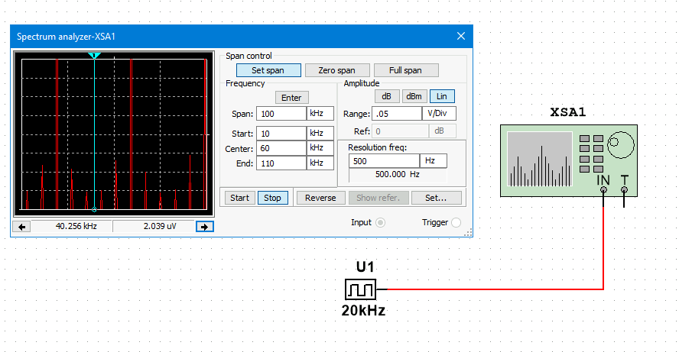
Baseband Signals
The following screenshots show the spectrum analyzer displaying the signal’s harmonic spectrum and its panel settings and the signal voltage at each of the frequencies.

Slide 5
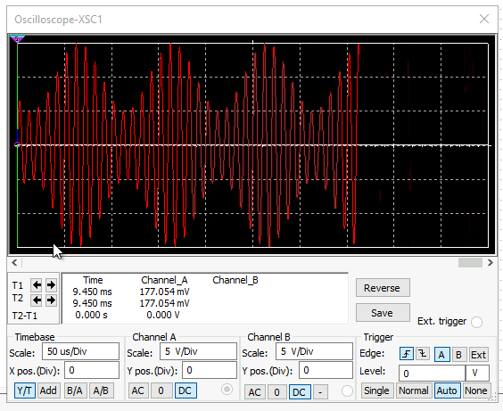
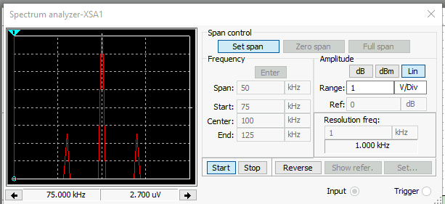
AM Signals
The following screenshots of the Oscilloscope and Spectrum Analyzer include the signal and the panel settings.

Slide 6
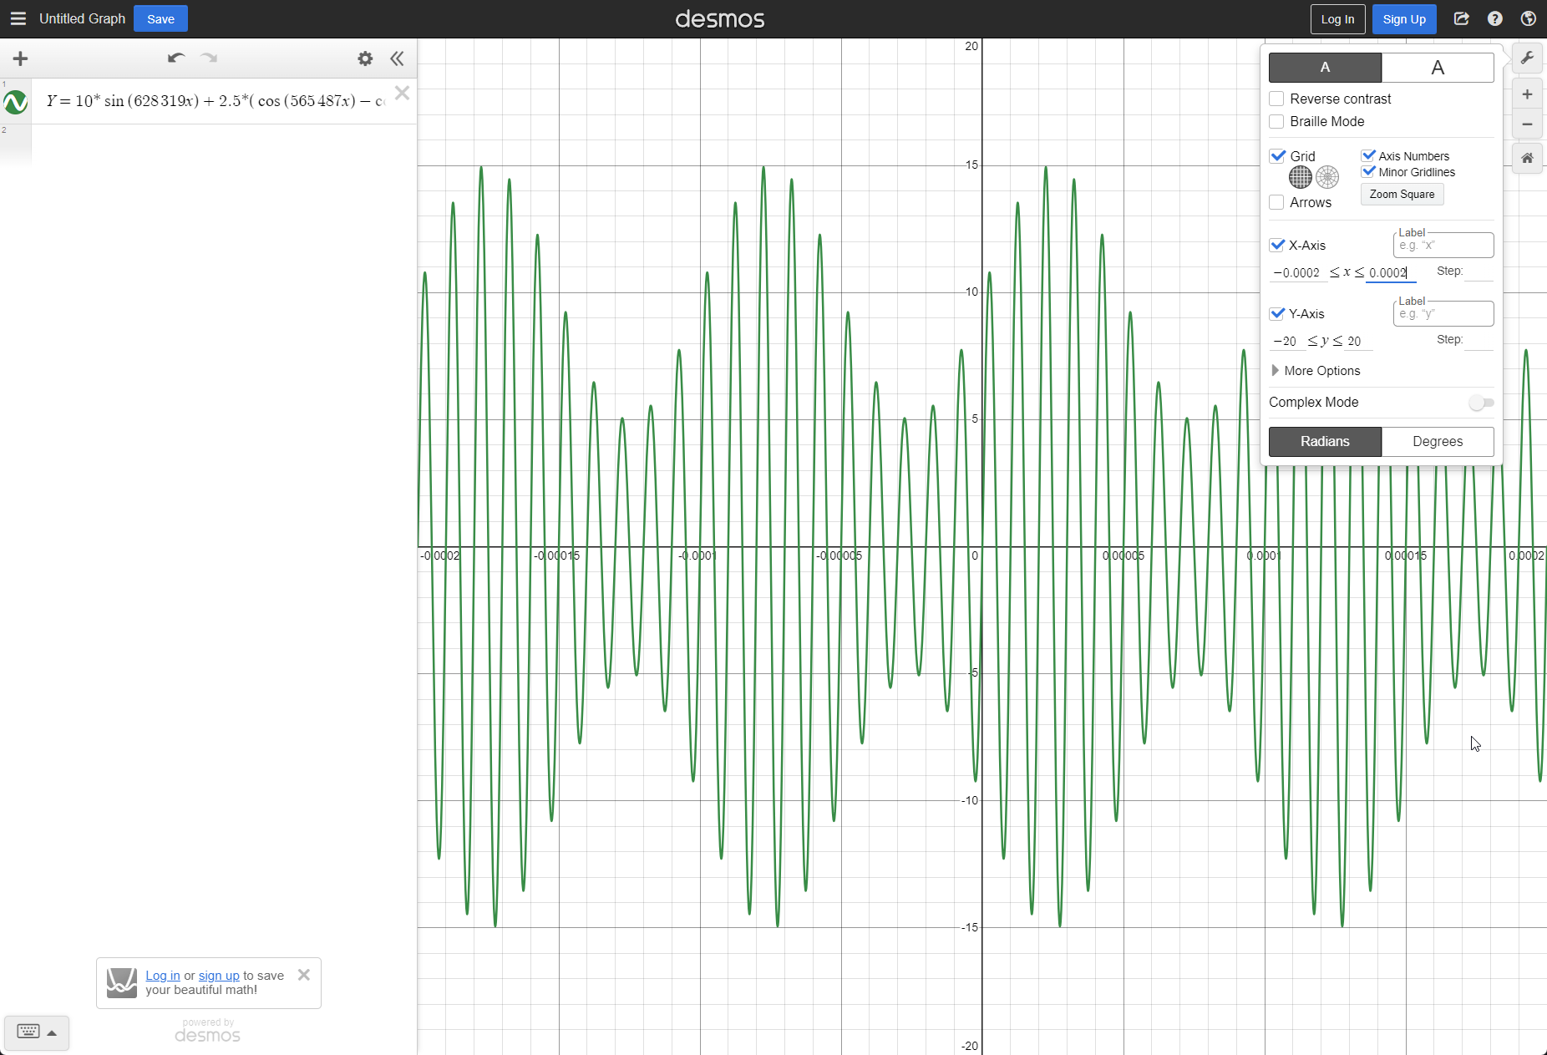
AM Signals - Cont.
We developed equations for the carrier and modulating signals and plotted the equation for the composite modulated signal V_{AM .}
Equations here:
Carrier Signal: Vc = 10sin($2π ∗100k)t=10sin⁡(200k ∗ π)t$
Modulating Signal: Vm = 10sin($2π ∗10k)t=10sin⁡(20k ∗ π)t$

Slide 7
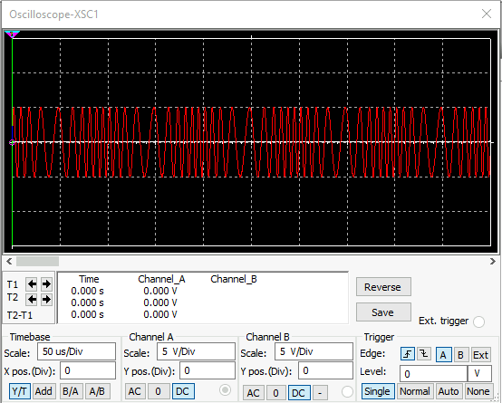
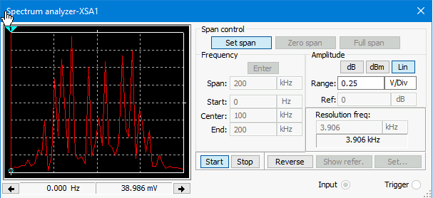
fM Signals
The following screenshots of the Oscilloscope and Spectrum Analyzer include the signal and the panel settings.
Carrier Frequency: 100khz

Slide 8
Module 3
Pulse Code Modulation (PCM) and Line Codes

Slide 9
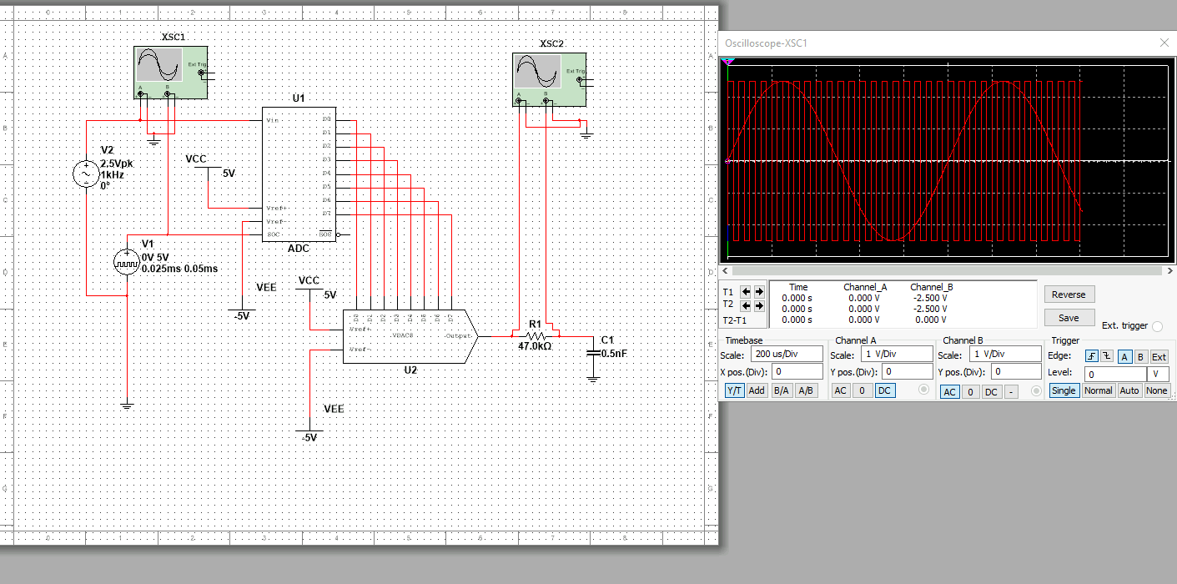
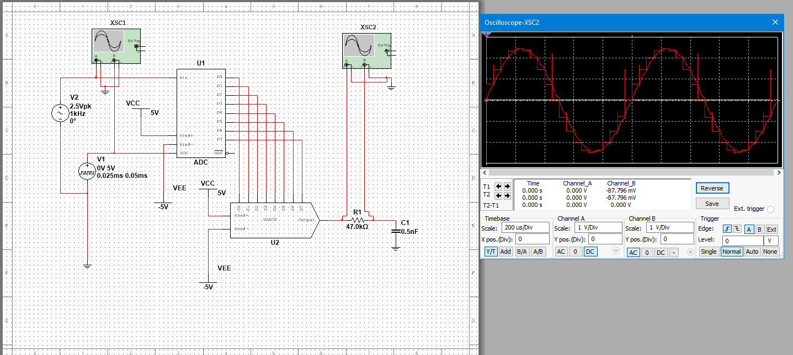
Pulse Code Modulation (PCM)
The first screenshot shows the Oscilloscope-XSC1 display with the analog input signal and sampling clock at the input to the ADC. The second screenshot shows the Oscilloscope-XSC2 display with the output of the DAC.

Slide 10
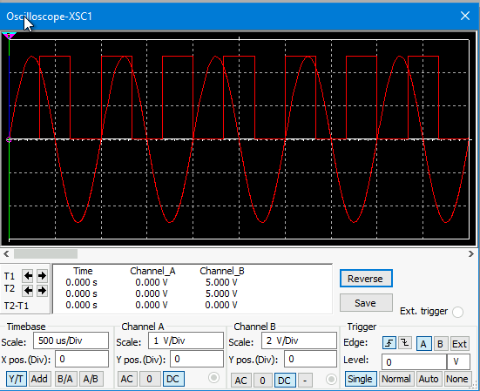
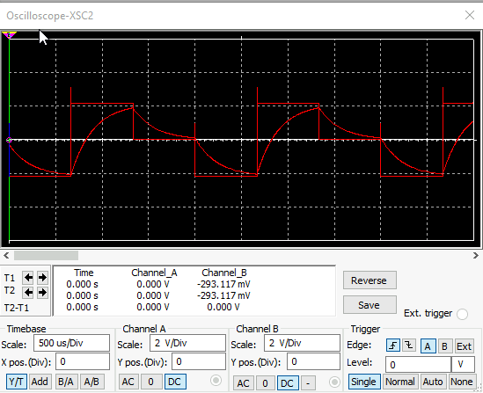
Pulse Code Modulation (PCM) - Cont.
Increasing the sampling rate improves resolution and results in larger data sizes and increased processing requirements and decreasing the sampling rate will reduce the resolution, potentially missing critical detail of the signal while resulting small data size and better processing demands. The following screenshots reflect this.

Slide 11
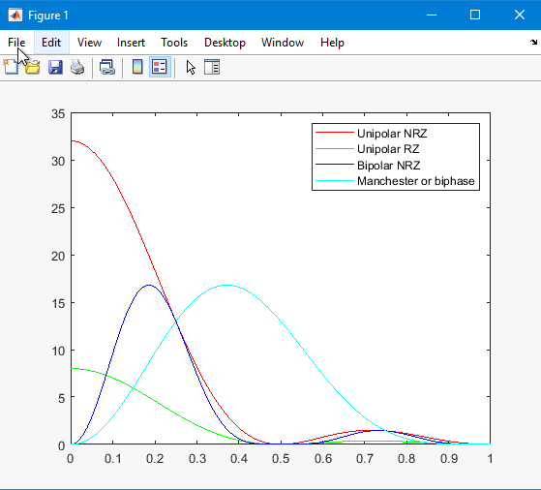
Line Codes
The following screenshot shows the power spectral densities of four-line codes: NRZ-Polar, NRZ-Unipolar, NRZ-Bipolar, and Manchester-Polar. The Manchester encoding requires more bandwidth than the NRZ-Bipolar encoding does.

Slide 12
Module 4
Cables and Structured Cabling

Slide 13
Cables and structure cabling
In structured cabling systems, maintaining the twisting in individual wires of an Unshielded Twisted Pair (UTP) cable is crucial as it minimizes electromagnetic interference (EMI) and crosstalk between pairs, ensuring reliable data transmission. According to the ANSI/TIA-569-B standard, UTP cables should be separated from unshielded power cables carrying 110 volts by at least 12 inches to prevent electrical interference that could degrade network performance. Horizontal cabling plays a vital role in connectivity, linking telecommunications rooms to individual outlets or work areas on the same floor, typically running above ceilings or below floors. Plenum-rated cables are designed for use in air circulation spaces within buildings, offering fire-resistant insulation that reduces smoke production, making them a safer option as per building codes. Similarly, riser tubes, or riser-rated cables, are used for running cables between floors and contain fire-resistant jackets to prevent the spread of fire across different levels. Lastly, grounding of equipment is primarily a safety concern, providing a path for fault currents to earth to prevent electrical shock hazards. However, proper grounding also improves performance by reducing electrical noise and enhancing overall cabling system efficiency.

Slide 14
Module 5
Antenna gain and free space path loss

Slide 15
Antenna Gain
This data highlights the relationship between frequency, antenna size, and gain, emphasizing how dish antennas optimize signal transmission.
Antenna Gain at 2.4 GHz: The maximum theoretical gain of a common dish antenna at this frequency is 22.379 dB.
Antenna Gain at 5 GHz: The maximum theoretical gain increases to 29.079 dB at this higher frequency.
Efficiency of High vs. Low Frequencies: Higher-frequency signals (e.g., 5 GHz) can be more efficiently focused by a dish antenna compared to lower-frequency signals.
VLA Radio Telescope Antenna Gain: At 5 GHz, the Very Large Array (VLA) radio telescope dish antenna achieves a -63.059 dB gain.
Size vs. Efficiency: Larger dish antennas provide higher gain and better signal focusing than smaller ones at the same frequency.

Slide 16
Free space path loss
This data highlights the importance of frequency selection and distance considerations in wireless communication system design.
Free Space Path Loss at Different Frequencies:
2.4 GHz Band: -80.4 dB
5 GHz Band: -87.2 dB
Observation: Higher-frequency signals (5 GHz) suffer greater loss than lower-frequency signals (2.4 GHz). This is due to FSPL being proportional to the square of the frequency (Friis transmission equation).

Slide 17
Free space path loss – Cont.
Free Space Path Loss Over Distance (2.4 GHz Band)
20 meters: -66.421 dB
40 meters: -72.441 dB
80 meters: -78.462 dB
Effect of Doubling Distance
Each time the distance doubles, FSPL increases by approximately 6 dB.
This follows the inverse square law, where signal power decreases by a factor of four when the distance doubles.

Slide 18
Module 6
Bit Error Rate of Fading Channels

Slide 19
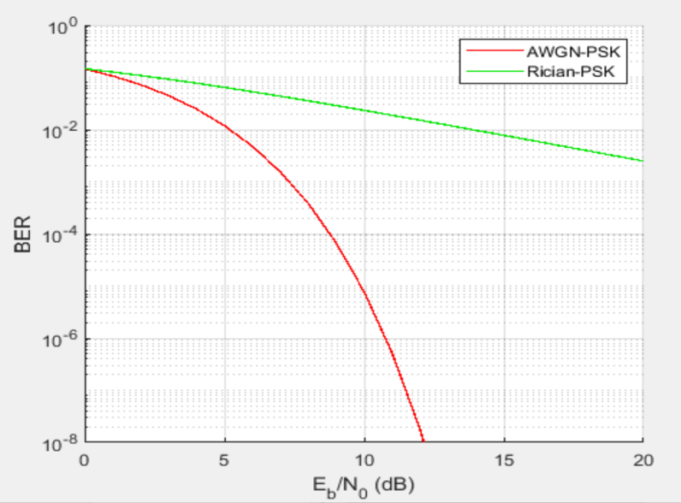
Bit error of fading channels
AWGN Channel and Rician Channel
The following screenshot shows the bit rate error performance of both AWGN and Rician fading channels.

Slide 20
Bit error of fading channels – Cont.
Bit Error Rate (BER) Performance of PSK in AWGN vs. Rician Channels
AWGN vs. Rician Channel Performance:
In an Additive White Gaussian Noise (AWGN) channel, PSK modulation performs more reliably, with lower bit error rates (BER) at the same signal-to-noise ratio (SNR).
In a Rician fading channel, PSK experiences a higher BER due to the multipath effects and fading characteristics, which degrade signal quality.

Slide 21
Bit error of fading channels – Cont.
Bit Error Rate (BER) Performance of PSK in AWGN vs. Rician Channels
Comparison at 5 dB SNR: AWGN channel shows significantly lower BER, and Rician channel introduces more errors due to multipath fading, leading to a noticeable BER increase.
Comparison at 10 dB SNR: The BER in the AWGN channel improves dramatically, achieving near-error-free transmission, and the Rician channel still experiences higher BER than AWGN, but the performance improves with increasing SNR.
Key Takeaway: AWGN channel provides better BER performance than the Rician channel at the same SNR levels and multipath fading in Rician channels significantly impacts PSK signal reliability, requiring advanced equalization or diversity techniques for mitigation.

Slide 22
Challenges
Understanding complex modulation and encoding techniques
Interpreting simulation results accurately
Configuring software tools for analysis
Managing time effectively to complete all modules

Slide 23
Career Skills obtained
In-depth knowledge of digital communication principles
Hands-on experience with signal analysis tools
Understanding of structured cabling and network transmission
Application of modulation and encoding schemes in real-world scenarios
Preparation for careers in networking and IoT development

Slide 24
Conclusion
This project has provided valuable insights into digital communication and networking concepts. Through practical simulations, I have gained a strong foundation in modulation techniques, structured cabling, and signal analysis. These skills will be instrumental in advancing my career in Information Technology and networking.

Slide 25
THANK YOU
Keith Warren​
www.madebykewa.com

