Slide 1
SEC290 Fundamentals of information Security
2024 Nov Session
Keith Warren
Prof. Burnette

Slide 2
introduction
Exploring the Core Objectives of Cybersecurity Mastery
Welcome to the journey through the fundamental principles and advanced practices of cybersecurity. This course is designed to equip us with the knowledge and skills to identify, analyze, and mitigate risks in today's complex digital landscape. Each week we built on critical objectives, from understanding risks to the CIA Triad and implementing network security controls to crafting secure networks and navigating the evolving job market. During this course, we dive into threat intelligence, vulnerability scanning, cloud security, infrastructure management, software and hardware assurance, and much more. Each week, we unlocked the tools and strategies needed to become a proficient cybersecurity professional in a rapidly digitizing world.

Slide 3
Basic attack analysis
Look at captures no. 20 and 22. (You can use the “Go” link at the top of the Wireshark screen to quickly go to a specific capture) Both packets are ICMP traffic but there are subtle differences between them. Compare the time-to-live and data field sizes in the two packets. What differences do you see?
The time-to-live for packet 20 is 64, while the time-to-live for packet 22 is 128. Packet 20 had a message length of 98 while packet 22 had a message length of 74.
Do a little Internet research to discover which operating systems use the specific values in their ping commands. What operating system generated the echo request in capture 20?
Packet 20 with the ping request 64 is using a Linux OS.
Review packet no. 37 and beyond, what do you think is taking place here?
Nmap stealth scan – Ports are not being scanned.
Look at capture 22846. What is suspicious about the flag settings in this packet?
I think due to the type of machine being used the flag setting differ.
What is the IP address of the host being targeted?
192.168.25.1

Slide 4
Open SSL
Creating and testing an SSL/TLS file
Take a screenshot of the output in Step 20.
It should show the GET request in the Info column.

Slide 5
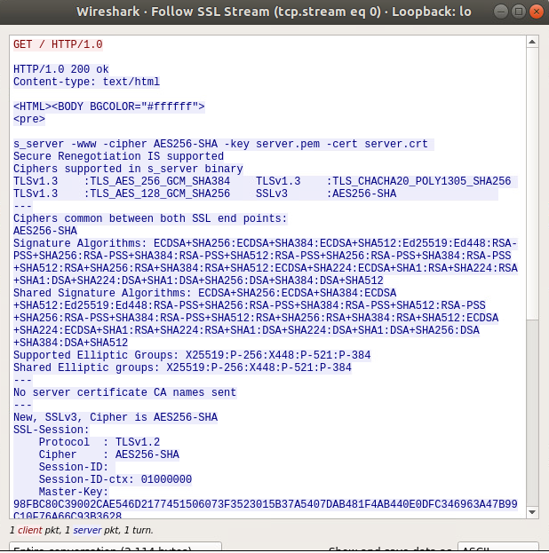
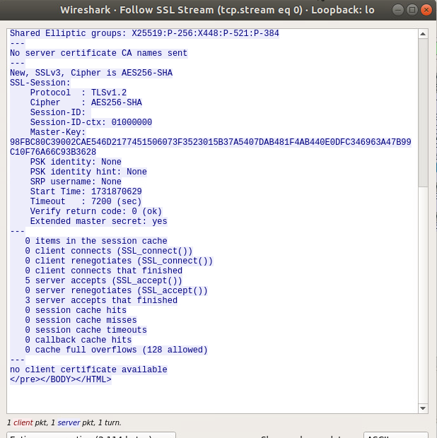
Open SSL
Creating and testing an SSL/TLS file cont’d
Take a screenshot of the output in Step 22.
It should show the decrypted SSL stream.

Slide 6
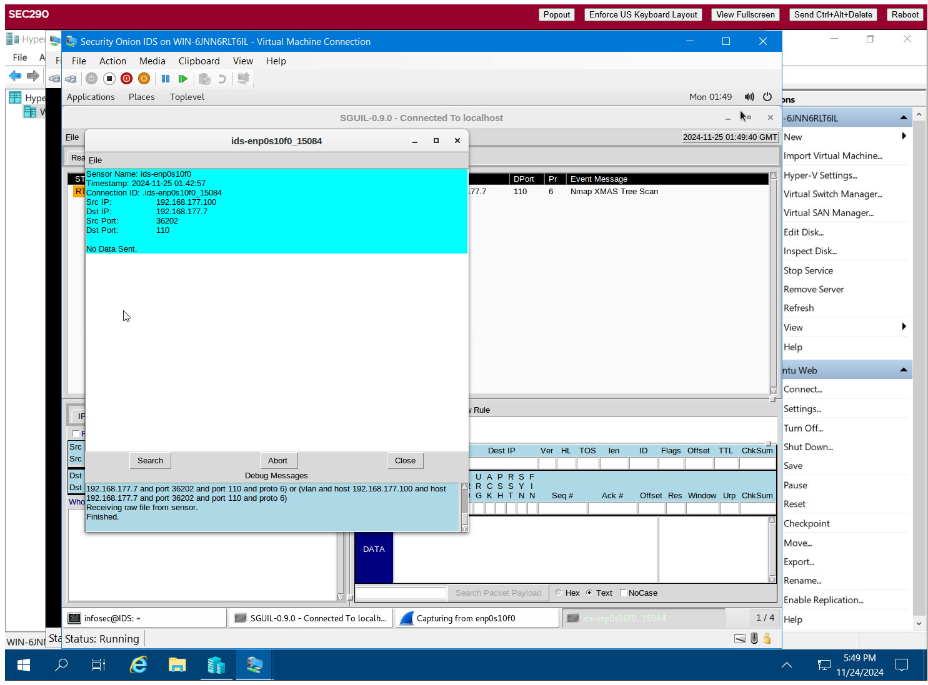
Snort
Testing Snort rules
Take a screenshot of the output in Part 1 Step 17.
It should show the transcript of the XMAS scan alert.

Slide 7
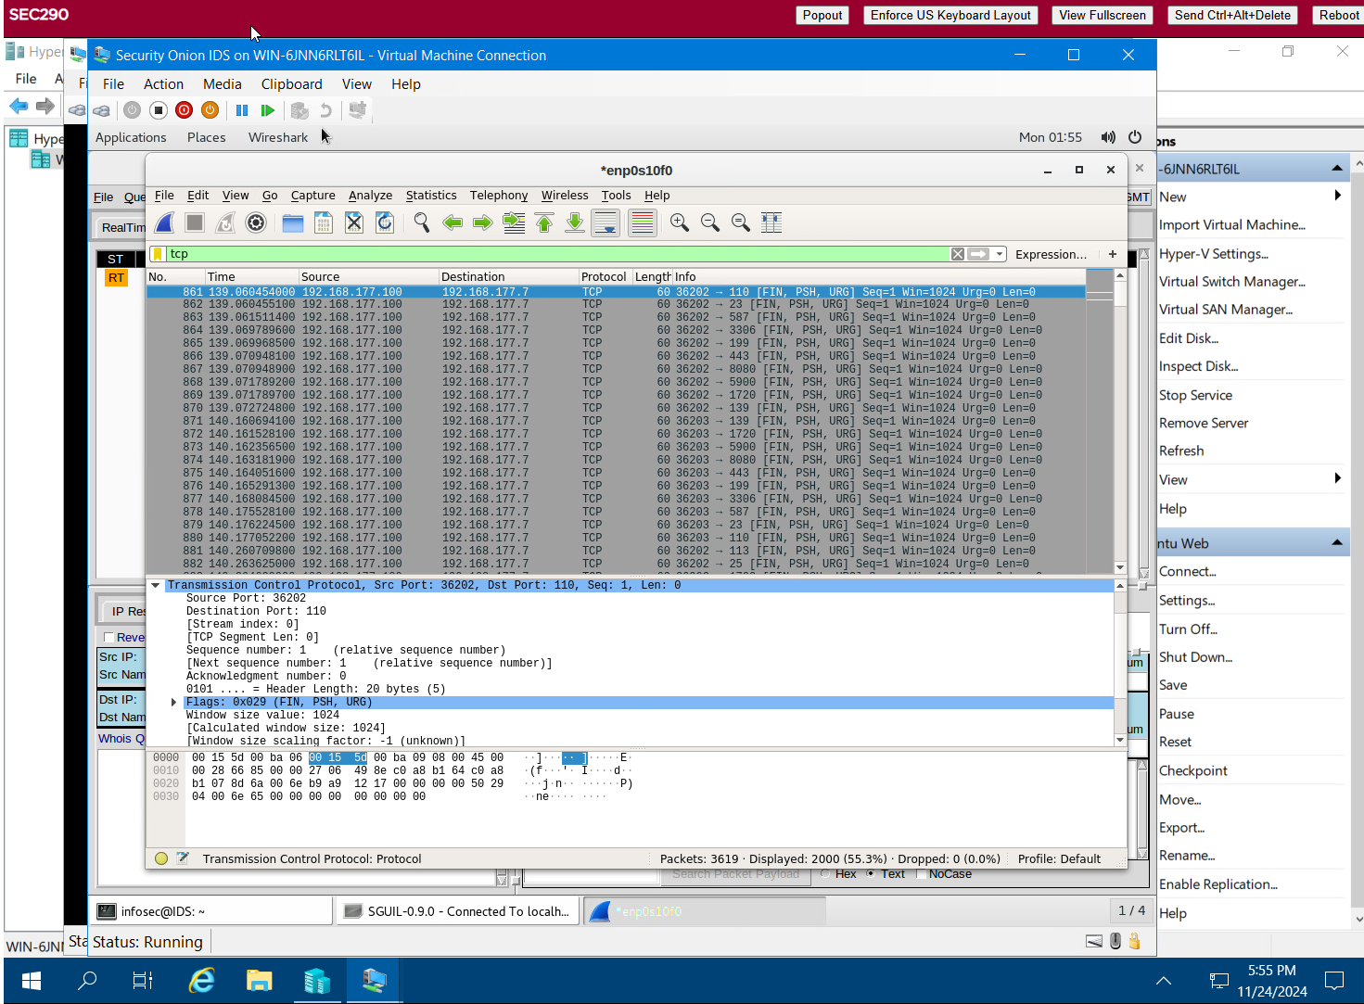
Snort cont’d
Testing Snort rules cont’d
Take a screenshot of the output in Part 1 Step 20.
It should show the TCP packets generated by the XMAS scan.

Slide 8
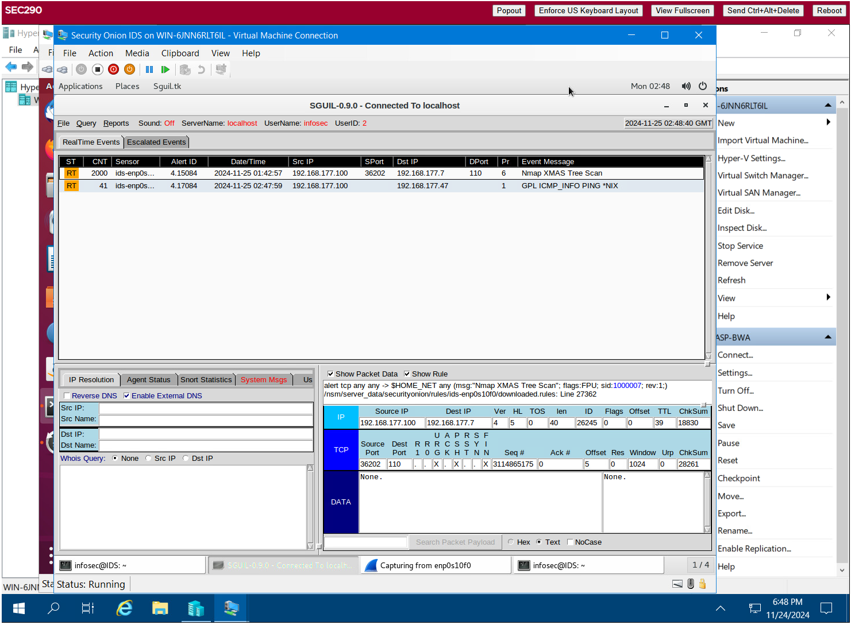
Snort cont’d
Creating Snort rules
Take a screenshot of the output in Part 2 Step 7.
It should show the ping activity alert.

Slide 9
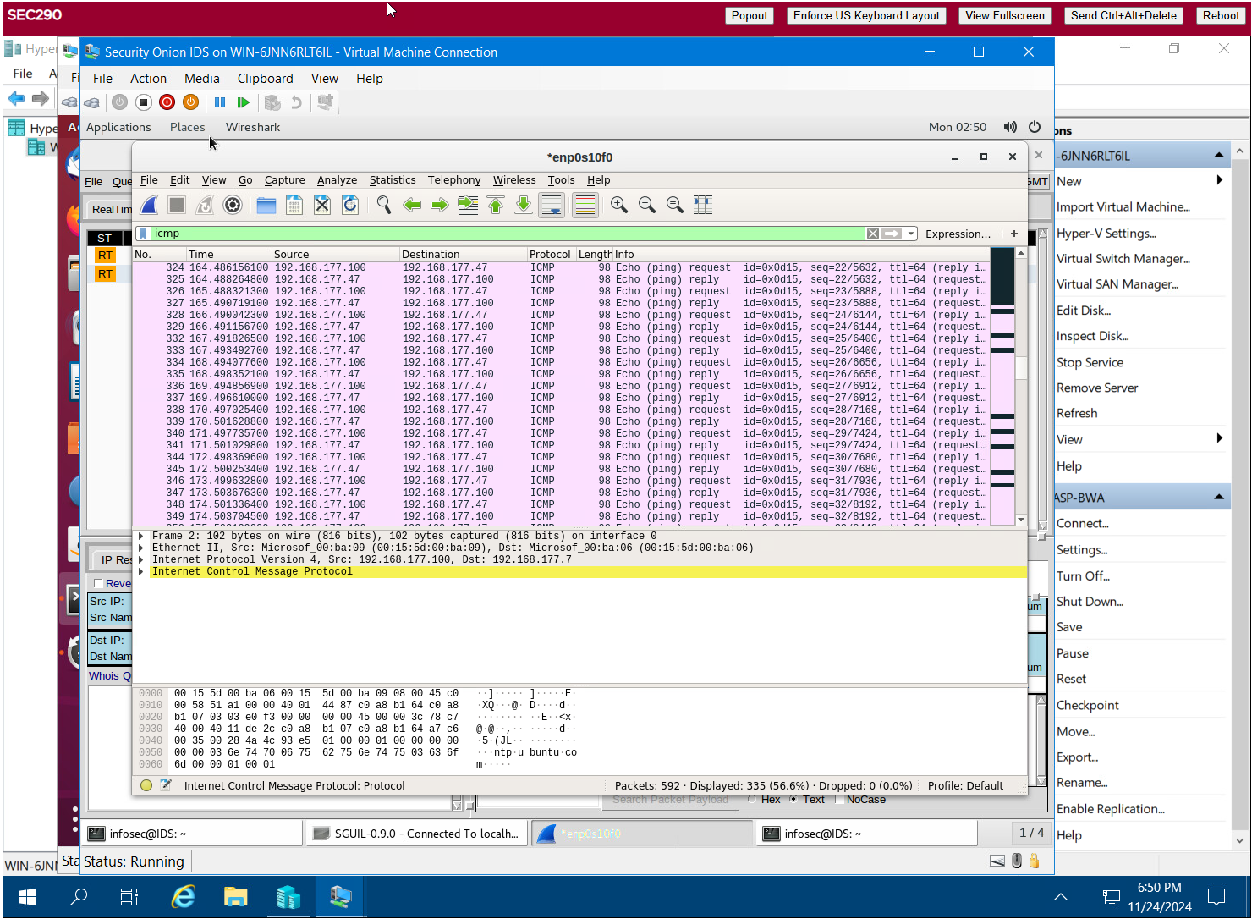
Snort cont’d
Creating Snort rules cont’d
Take a screenshot of the output in Part 2 Step 8.
It should show the ICMP packets generated by the ping activity.

Slide 10
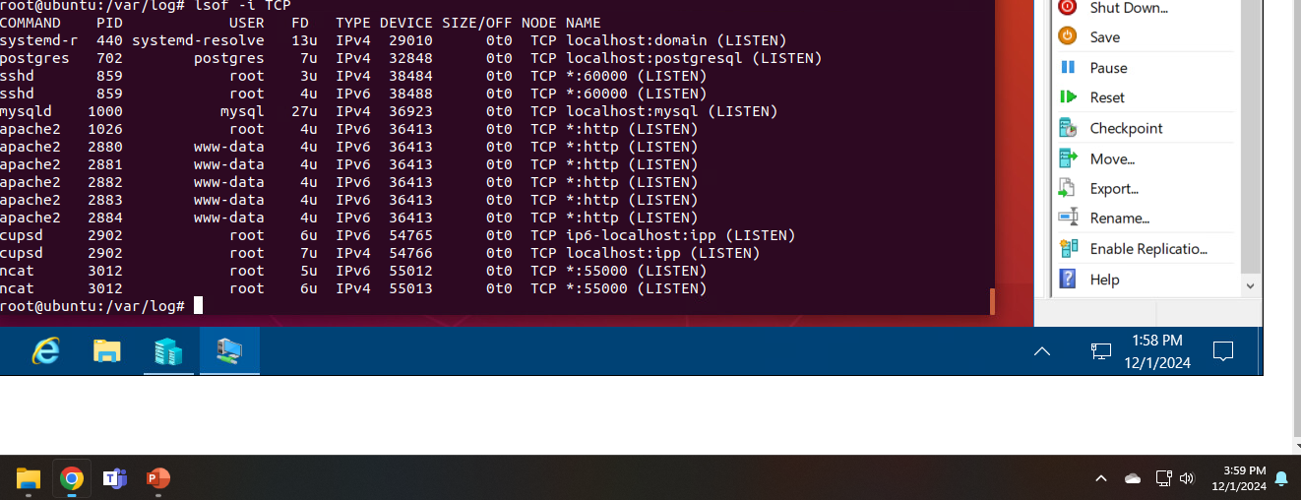
Live Memory Analysis
Linux Processes
Take a screenshot of the output in Part 1, Step 16.
It should show port 55000 open for both IPv4 and IPv6.

Slide 11
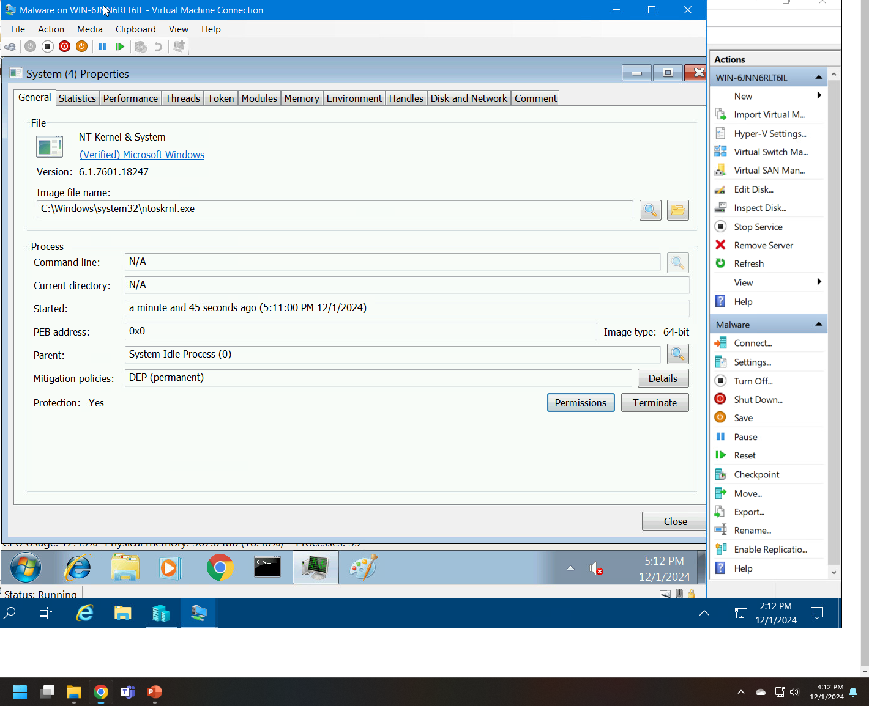
Live Memory Analysis cont’d
Process Hacker
Take a screenshot of the output in Part 2, Step 5.
It should show properties of a chosen process.

Slide 12
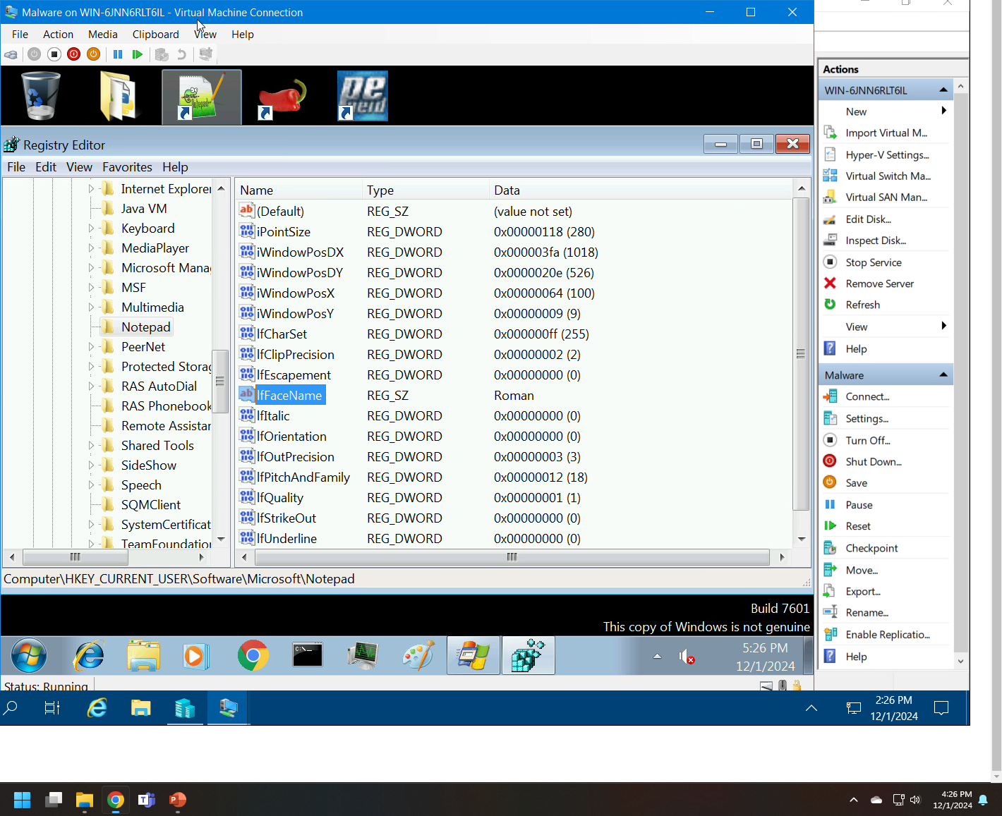
Live Memory Analysis cont’d
Process Monitor
Take a screenshot of the output in Part 3, Step 13.
It should show ifFaceName in the Path column and Data: Roman in the Detail column.

Slide 13
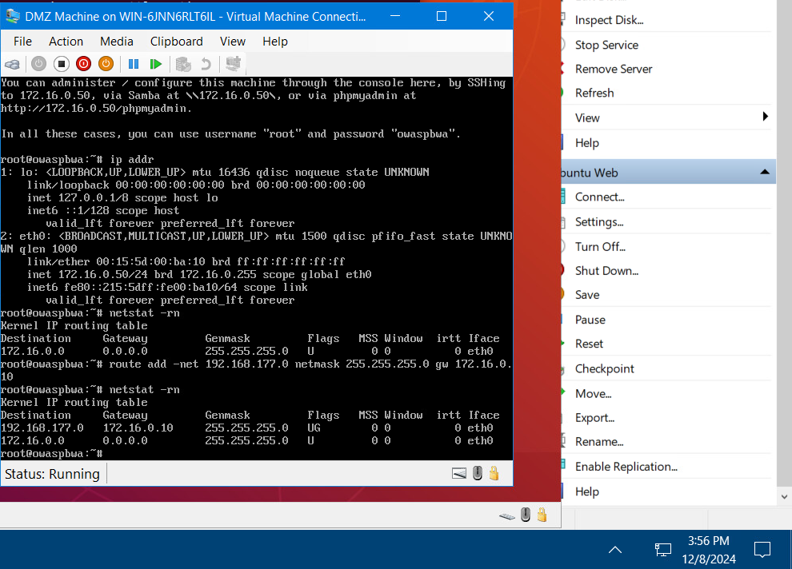
FirewaLL
Time-based Access
Take a screenshot of the output in Part 1 Step 21.
It should show the output of the DMZ Route Table.

Slide 14
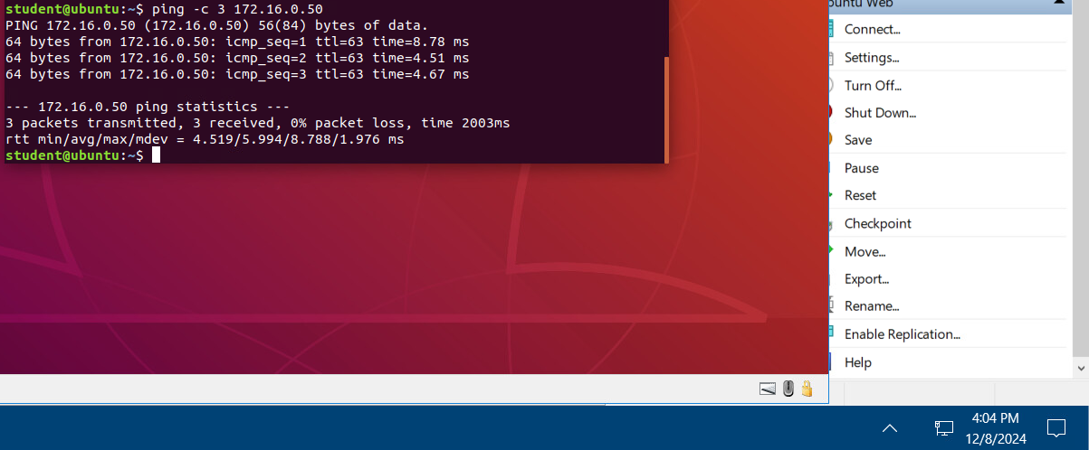
FIREWALL CONT’D
Time-based Access
Take a screenshot of the output in Part 1 Step 26.
It should show a successful ping from the Ubuntu Web VM and the DMZ VM.

Slide 15
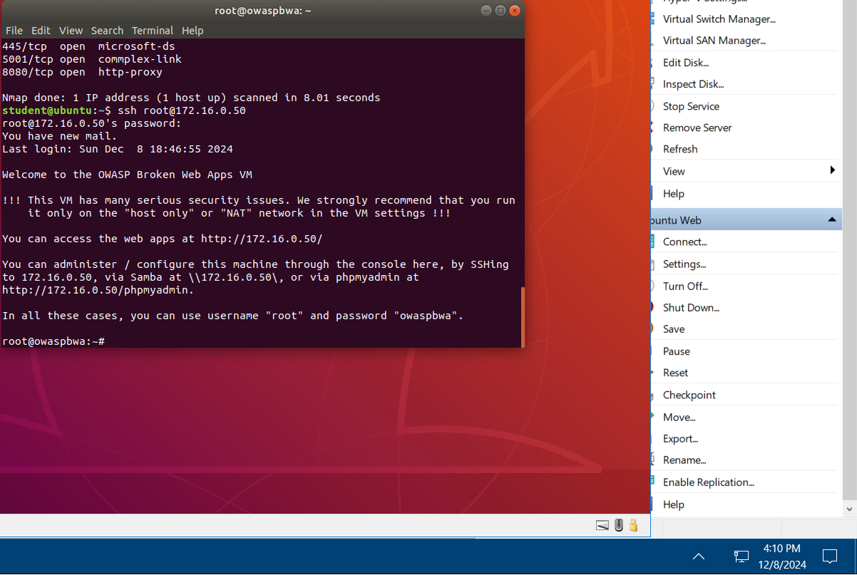
firewall CONT’D
Time-based Access
Take a screenshot of the output in Part 1 Step 34.
It should show two time-based access rules in the FORWARD chain

Slide 16
Challenges
Keeping up with the rapidly evolving nature of cybersecurity threats
Solution: I can subscribe to industry-leading threat intelligence platforms, participated in cybersecurity forums to stay up to date. Additionally, I can allocate dedicated time for professional development, enabling me to anticipate and counteract new threats effectively.
Keeping up with emerging standards and best practices
Solution: I can network with peers and attend industry events to help me adapt to changes.
Keeping up with rapidly changing job requirements and roles in cybersecurity
Solution: I will stay agile by diversifying my skillset through online courses and certifications in emerging technologies. Regularly reviewing job market trends will help me anticipate changes and align my career trajectory accordingly.
Understanding how new technologies and trends shape the job market
Solution: I will explore hands-on projects and case studies in these technologies to understand their implications. By integrating these skills into my profile, I will position myself as a forward-thinking cybersecurity professional.
Identifying and addressing skill gaps to remain competitive
Solution: I will perform periodic self-assessments and sought mentorship to identify areas for improvement. By setting clear learning goals and leveraging platforms like Coursera, Udemy, and LinkedIn Learning, I will be able to close these gaps effectively.

Slide 17
Career skills obtained
Technical Skills
Strategic and Analytical Skills
Risk Management and Mitigation
Threat Intelligence Utilization
Vulnerability Assessment
Cloud Security
Infrastructure Security
Incident Response
Security Monitoring
Secure Network Design
Cybersecurity Policy Development
Risk Evaluation
Security Data Analysis

Slide 18
conclusion
In this course, we have explored the dynamic and evolving field of cybersecurity, focusing on foundational concepts and practical applications. Starting with the essential risks to the CIA Triad and the corresponding network and endpoint security controls, we built a comprehensive understanding of the tools and techniques required to safeguard modern digital environments.
Throughout the course, we:
Utilized threat intelligence to bolster organizational security strategies and performed vulnerability scans to identify and address potential weaknesses.
Delved into the threats and vulnerabilities of cloud environments, emphasizing the importance of proactive security solutions in infrastructure management.
Discussed software and hardware assurance best practices and gained skills in analyzing security monitoring data.
Investigated the incident response process, understanding its phases to effectively respond to and mitigate cyber threats.
Evaluated risk management techniques, cybersecurity policy frameworks, and the implications of emerging trends in the digitized job market.
Finally, we synthesized these concepts by focusing on the creation of secure networks, tying together our learning into actionable insights.
This journey has equipped us with the knowledge and skills to meet the challenges of cybersecurity head-on, preparing us to protect and enhance the digital resilience of organizations.

Slide 19
Thank You
www.kewa.io

